Slide 1
Creating ArcReader Projects for Local History
Robert Jones, Associate Professor
Skidmore College rjones@skidmore.edu
Spring NEARC 2013

Slide 2
What this Presentation Covers
ArcMap projects created for local use by ArcReader
on a hard drive, CD, DVD or flash drive
ArcMap and ArcReader 10.0 were used for this presentation
What is NOT covered in this presentation
ArcGlobe package

Slide 3
ArcMAP is . . .
Expensive for many potential users
Especially non-profit organizations
Independent map users
Difficult for many users to learn
Not intuitive
Many up-front concepts to understand
Especially for occasional users
Easy to forget how to do things if not used often

Slide 4
ArcReader is . . .
Free
Can be downloaded or distributed to any user
A Simplified version of ArcMap
Brings interactive mapping to anyone with Windows
Has the look and feel of ArcMap
ArcReader can only read, not create, maps
Easy to learn
Uses tools common to many other applications
Zoom in and out
Pan
Print

Slide 5
ArcPublisher
License required for this ArcGIS Extension
Creates ArcReader projects
Based on “.mxd” files
Creates two folders
A “PMF” folder for the project and hot linked files
A “DATA” folder containing features and rasters

Slide 6
Historians’ Geographic Needs
Get frequent geographic requests such as
“What is there now?”
“What was there before _______?”
“Where are old cemeteries in ______ ?”
Have difficulty finding same locations from paper maps
Some of which are stored in vaults and are only copies
Many of which are different sizes
Many of which have different features noted on them
Need easy access to geographic layers
Need to print portions of larger maps
Often for different time periods for the same extent

Slide 7
Some things ArcReader Can Do
Turn layers (and/or groups of layers) on and off
Zoom in and out
Pan
Print
Export maps (as .bmp files only!)
Use the Identify tool
Change transparency of layers
Swipe Layers
Use hyperlinks
Measure distances
Mark up a map (using pen or highlighter)
Query (limited)
Switch between data and layout view

Slide 8
Toolbars
ArcMap Toolbar
ArcReader Toolbar

Slide 9
ArcReader Cannot
Add new data layers
Create new layers from existing layers
Change colors of features
Turn labels off or on
Change the order of layers in the table of contents
View an entire attribute table
Save changes to a .pmf file

Slide 10
Saving the ArcReader Package
The ArcReader package can be saved in one of three formats
Existing format (shape files and rasters)
File geodatabase
Compressed file geodatabase
Compressed GDB (not using existing format) takes up about half the space of the other ArcReader formats
ArcReader packages take up 5 times the space of a map package (.mpk)
2.5 times the space for a Compressed GDB

Slide 11
ArcMap and .pmf Files
ArcMap (using the Publisher extension)
Can create .pmf files
Cannot open .pmf files

Slide 12
Opening and Editing Files in the ArcReader Data Package
ArcMap can modify the contents of files within the package
depending on the data package format chosen
ArcMap
Can open and edit files saved as
“Existing format”
File geodatabase
Can open, but not edit, files in Compressed GDB
Cannot open files in Compressed and Locked GDB

Slide 13
Changing the .pmf File
Each .pmf file is created from a .mxd file
.pmf files cannot be edited once created
Changing the pmf file
Must change and save the .mxd file
Then republish a new .pmf file
Presumably if the files in the DATA folder are the same
Only the pmf file needs to be changed

Slide 14
Modifying ArcReader Packages
A new .pmf file for a given DATA folder can be can be created
Files within the DATA folder can be edited
unless they are compressed
Not possible to add new files to a DATA folder without creating a new package

Slide 15
A Sample ArcReader Project Cemeteries in Town of Greenfield, NY
Project Contents
Most recent aerial photos as a group layer
Streets layer
Parcels layer
Cemeteries as points with hyperlinked documents
Word documents contain links to web pages for each cemetery
Word documents contain directions and sketch of each cemetery
Several cemeteries are hidden in what are now forestlands
Word documents provide a photograph, parking and access information for each cemetery
Some are on private property

Slide 16
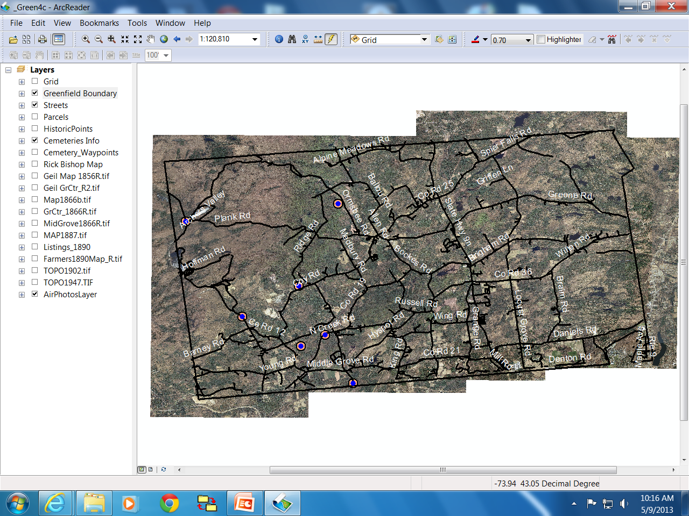
Greenfield, NY Cemeteries ArcReader Project

Slide 17
Some Benefits to Greenfield
Town Historian reports that much time is saved looking the history of a given place
Enables Town Clerk to include previously unknown cemeteries on deeds
Some property owner did not know that their parcel contained a cemetery!
Greenfield is largely rural
Was once heavily farmed in 1700’s
Most farming ceased by late 1800’s

Slide 18
Next Steps in the Greenfield Project
Historic Places of Interest in ArcReader
Pictures, short videos and other information about selected historic sites

Slide 19
Other History Projects: ArcReader for Other Towns
Requested (suggested) by other Saratoga Town Historians
Assigned GIS Class students to create a town map
Each student was assigned one of the towns/cities in Saratoga County
Created an ArcReader projects for their assigned town/ city containing
Streets layer
Town/city Boundary
All available historic maps georeferenced and clipped to boundary
All available topographic maps georeferenced clipped
Environmental layers clipped to town/city boundaries
Bedrock, soils, surficial geology, wetlands, watersheds, land cover, fault lines
Most recent aerial photography for the town or city
Provides a civic engagement project for students
And to their portfolio for future GIS job applications
Perform a needed public service beyond the expertise of the end users

Slide 20
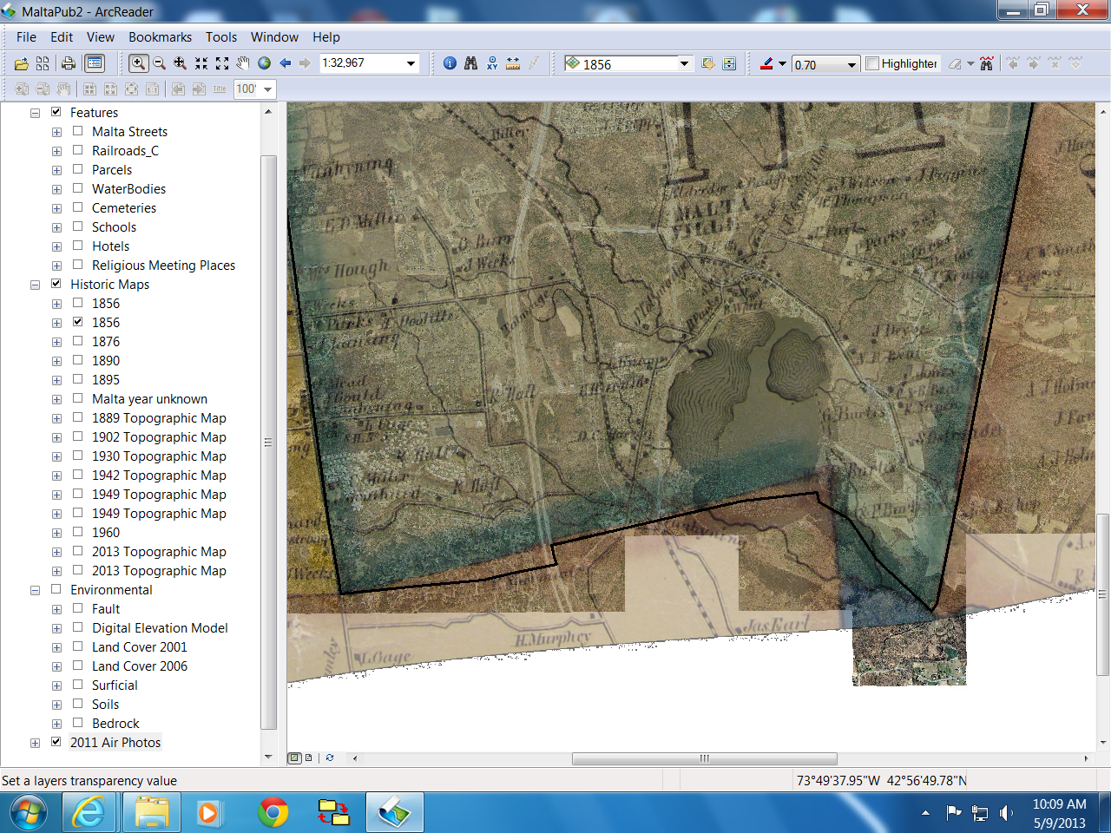
Student Created ArcReader Project Town of Malta, NY

Slide 21
Special Project for Saratoga Springs
The City has hundreds of historic maps
Different historic maps are stored in various major locations
Many are 200 year old originals in vaults for their own protection
Not easily available to the public
Saratoga Springs mapping project
Using ArcReader to make historic map layers available
In ArcReader
And in .kml formats for Google Earth
See temporary web site: http://www.skidmore.edu/~rjones/SSHIST/index_sshist.htm

Slide 22
http://www.skidmore.edu/~rjones/SSHIST/index_sshist.htm

Slide 23
Things to Consider when Creating ArcReader Projects
The layers can be created as accessible outside of ArcReader
If accessable
ArcMap can modify the layers
ArcMap can add or delete layers and republish a new .pmf file for the Data folder files
Creating a new map package can be time consuming
30 minutes is not unusual
Republishing a new .pmf file takes only seconds
similar to saving an ArcMap (.mxd) project file

Slide 24
More Things to Consider
Work with the end user when creating the package
Unless you are extremely familiar with their uses and needs
Have end-users explain how they use ArcReader projects to other similar end-users
Many end-users are not experienced technical people
Have a process for updating their ArcReader project as needed by them
Try to make end-user into independent users

Slide 25
Closing Comments
Not all capabilities of Publisher and ArcReader were contained nor tested for this presentation
For more information see:
http://help.arcgis.com/en/arcgisdesktop/10.0/help/index.html#/Welcome_to_the_ArcGIS_Help_Library/

