Slide 1
Using GIS to Research (and find) Seabirds
A Conservation and a Recreational Bird-Watching Perspective
Naeem Yusuff
University of Massachusetts Boston, GIS Certificate Program
Anne-Marie Runfola
Michael Thompson
Stellwagen Bank National Marine Sanctuary
Notes:
Thank you for the chance to present here today. The first part of talk about a citizen-science project in the Stellwagen Bank Marine Sanctuary off the coast of MA, monitoring seabirds – the second part of the talk will be about pelagic recreational bird watching with the Brookline Bird Club. The common thread is that in both of these projects GIS has been used to look at the data organize and analyze the seabird sightings. The goals of these two projects are really different, in the first NOAA wants to rigorously collect seabird data and in the second people really just want to see birds, preferably really rare ones. collected in these two projects.
Collaborators on this presentation – AnneMarie and Michael.

Slide 2
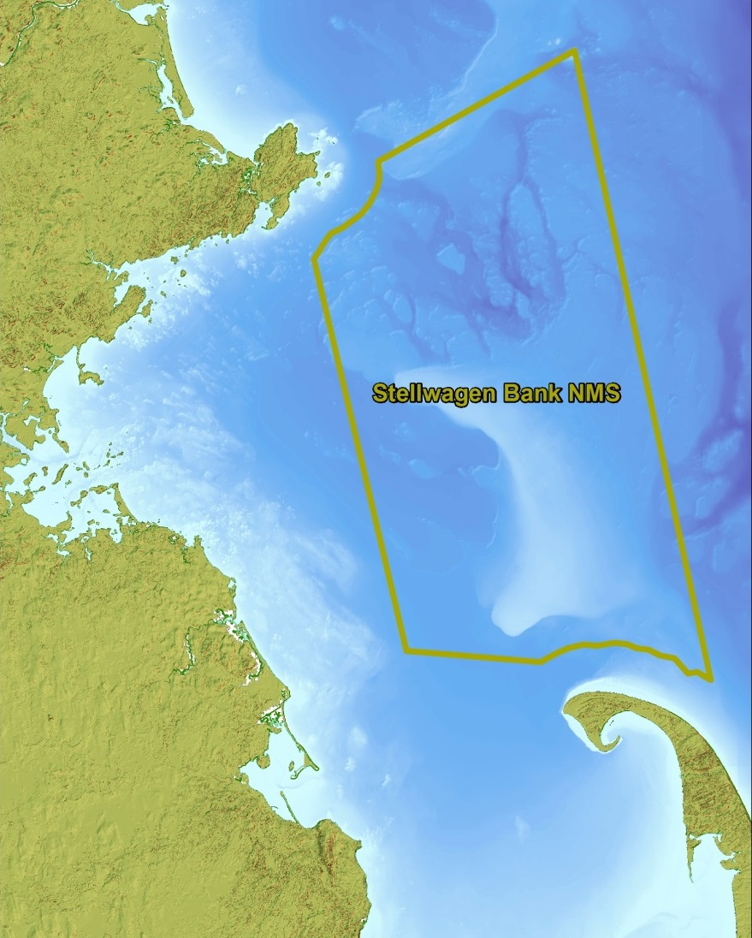
Stellwagen Sanctuary Seabird Stewards (S4)
Research
Systematically collect baseline data on seabirds in sanctuary boundaries to compare populations over time
Education & Outreach
Educate the public about seabirds and connect residents with their sanctuary
Citizen Science
Train observers to join our scientists in this groundbreaking project
Notes:
Stellwagen Bank an 842 sq mile marine sanctuary, is an underwater plateau (100-120 feet deep), while the surrounding waters are 300-600 ft deep. This underwater feature causes upwelling, nutrients, minerals, and mixing of the water column, leading to a ecologically rich marine environment. Perhaps best known for the whales, but also fish, and less studied – the birds. For example the last complete seabird survey was conducted in the 90’s. same geological feature that formed cape cod – receding galcial moraine.
S4 prgram was set up in 2011 to look at the seabirds…. Completed the triumverate

Slide 3
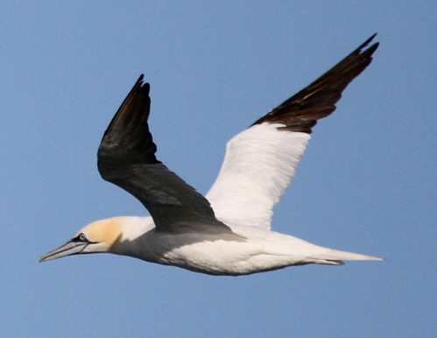
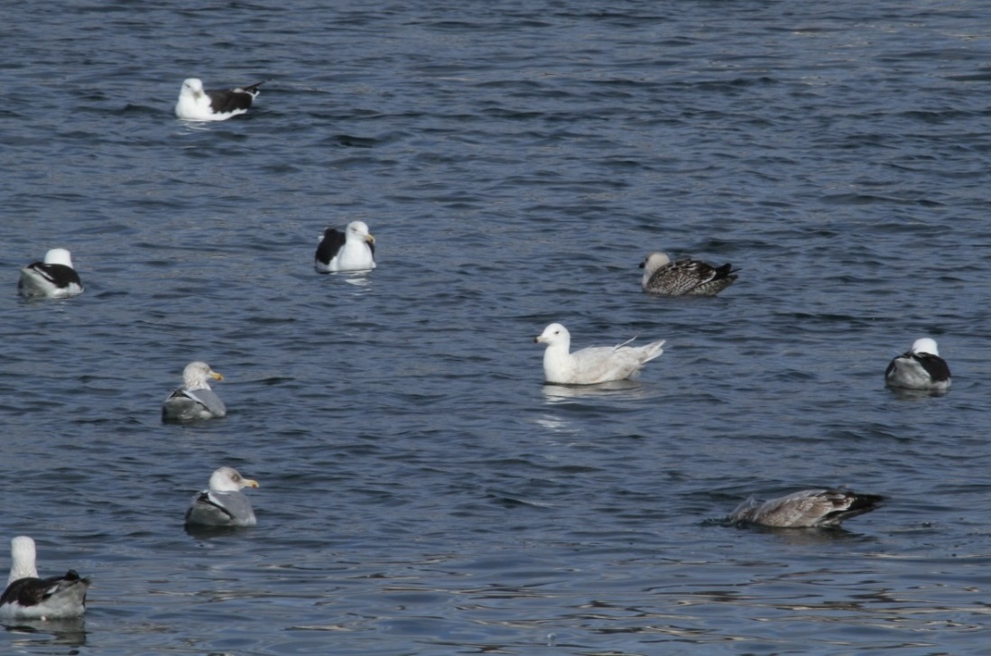
Birds of Stellwagen Sanctuary
Gulls and gannets are year-round visitors to
Stellwagen Bank Marine Sanctuary
Notes:
Before we go much further I wanted to show you some of the birds that we are talking about – some of the perhaps less interesting birds on stellwagen are the gulls – but they too can be interesting, for exmaple in this picture here we have three different species of gulls, a couple of different plumages… so they can still be challenging. They are year round residents although the numbers and the species composition of the gulls changes throughout the year. On the right here is another bird that is seen on the sanctuary throughout the year – the northern gannet. It is in the Sulid family, and is pretty closely related to boobies.

Slide 4
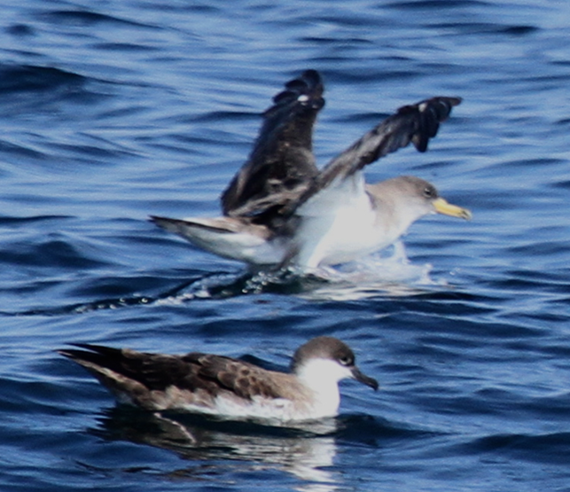
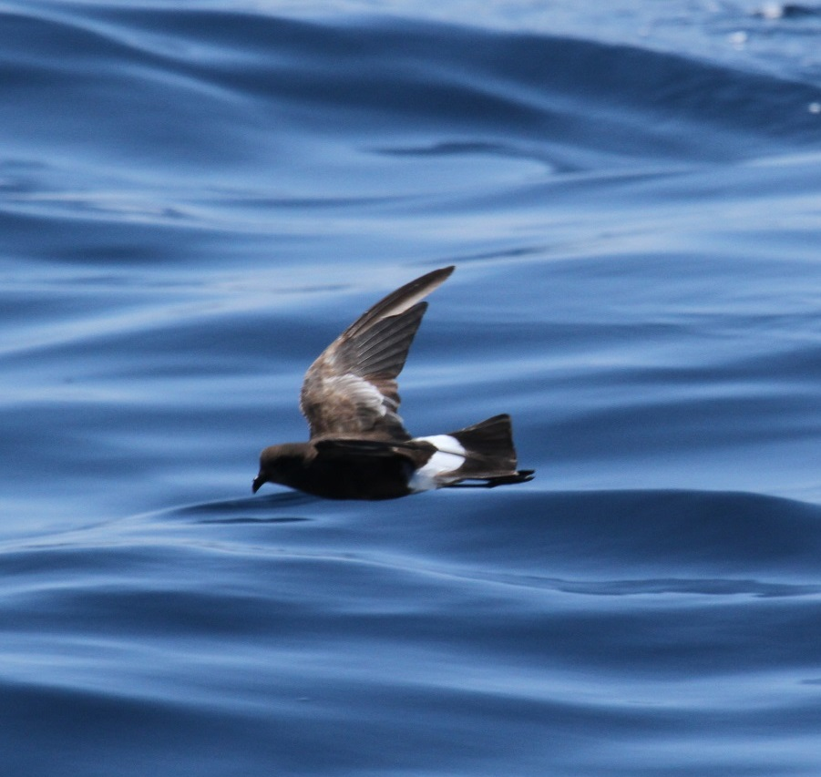
Birds of Stellwagen Sanctuary
Far-flung summer visitors include shearwaters and
storm-petrels
Notes:
These are some of the more exotic summer visitors to SB… these birds are called shearwaters, and unlike gulls they spend their entire lives at sea, only coming on land to breed. And they are long distance travellers, the COSH breeds in the eastern atlantic, the canary islands and azores, and this bird the great shearwater breeds in the south atlantic – tristan de cuna. I had to look it up on a map, it is way south in atlantic, about equidistant between SA, Africa and Antarctica. Southern hemisphere breeders, so they are summer visitors here during the austral winters. This little guy – about the size of a robin is thought to be the most numberous bird on earth (besides chickens) they too breed in the wouthern hemisphere and are here for the austral winters.

Slide 5
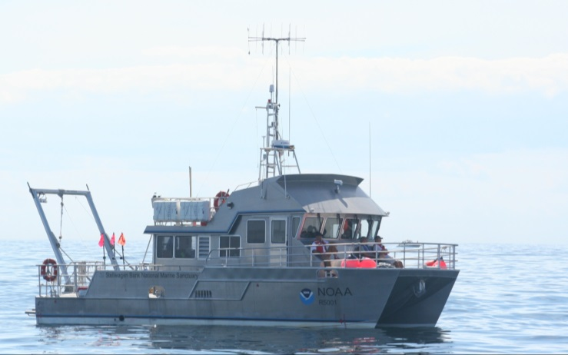
Survey Data Collection
Location
Species (and number)
Range & Bearing
Behavior
Association
Flight height
Flight direction
Standardized
Opportunistic
Notes:
Method
We are using two primary methods to collect data:
Standardized Survey
The R.V Auk runs full-day cruises at least five times per year, including one in conjunction with the Christmas Bird Count (CBC), and requires at least one staff member and six trained volunteers per trip: two teams with one recorder and one observer each, plus a third team for rotation, plus one dedicated marine mammal observer to ensure animal safety as we navigate the sanctuary. Stewards not observing or recording may be asked to photograph birds, help with data entry or act as backup observers, especially if less experienced. Team A collects data on one side of the boat within a 300 meter range, to follow a strict strip and line transect methodology. Team B on the other side of the boat collects bird sightings without a range limitation. This allows more birders to be involved and to obtain on-the-job training, and to add to the list of species seen in sanctuary waters.
The team follows the standardized transect set two years ago for the CBC. Tracks are laid out in east-west segments 2.5 nautical miles apart. The end points of each track intersect the 40-meter bathymetry line, keeping the count area on top of the bank. The tracks range the entire length of the bank, for a total length of 63 nautical miles and comprise a subset of a study area developed by David Wiley, sanctuary Research Coordinator. Stewards collect data during travel to and from the transect lines to compare populations inside and outside the sanctuary.
SBNMS staff and stewards use the ship’s main GPS unit as well as at least one backup unit to track course. Stewards will use the GPS unit to record local time to be synched with tracks and a paper datasheet or electronic database to list sightings. Staff will collect datasheets or database after each trip and will download tracks to be input into an SBNMS database.
Data collected for each sighting: Local time (using GPS), Species, # of Individuals, Behavior, Association, Bearing, Range, Flight Height, Age, Plumage, and Comments. Effort data (observation conditions) are also collected. We have started to collect sonar data for potential future study of prey populations and their associations with seabirds.
Opportunistic Data Collection: Whale Watch Vessels
Two volunteer stewards per week have the opportunity to observe birds on each participating company’s whale watch vessels from approximately June - October. Trips run approximately four hours. We work with three participating companies currently – Captain John (Plymouth), Hyannis Whale Watch (Barnstable) and Dolphin Fleet (Provincetown). Hyannis Whale Watch has chosen the S4 program to meet their stewardship requirement for Whale SENSE (http://whalesense.org/). We are in the process of establishing relationships with operators in Boston, Gloucester and Cape Ann to have better coverage of the sanctuary and opportunities for volunteers to collect much more data.
Pairs of stewards (one recorder and one observer) record all sightings, using a GPS unit to track course and time, and a paper datasheet to list sightings. After each trip, stewards enter data in a spreadsheet, scan originals, and download tracks from the GPS to send to SBNMS.
Data collected: Effort, Local time (using GPS), Species, # of Individuals, Behavior, Association, Flight Height, Age, Plumage, and Comments.
A huge range of data is collected – including location, species, range bearing (estimates) codes for behavior, association, flight height&direction. The fact that so much data is collected means that you can really make some cool maps splitting out sightings by species, behavior just by doing definition queries in arcmap.

Slide 6
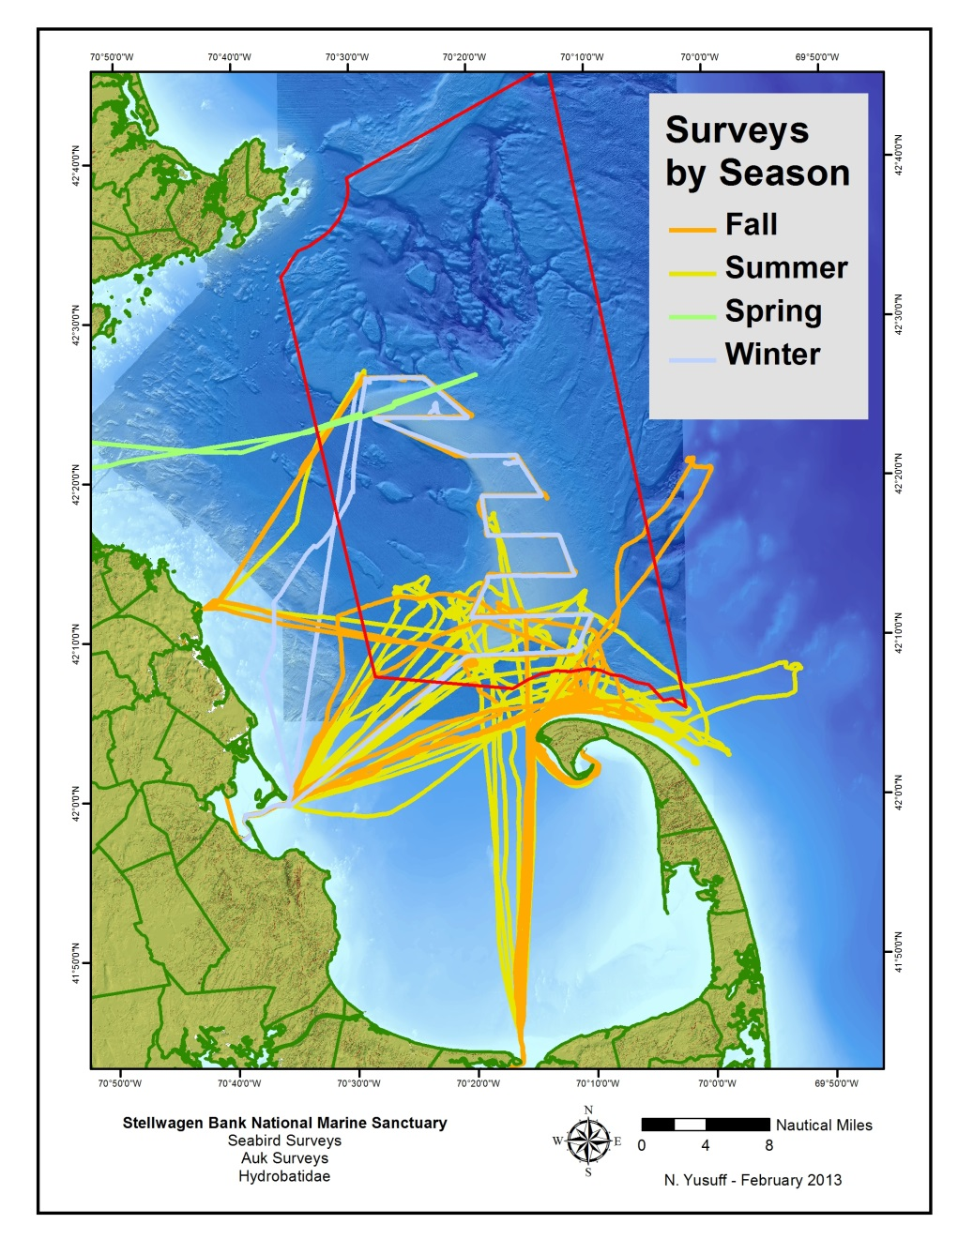
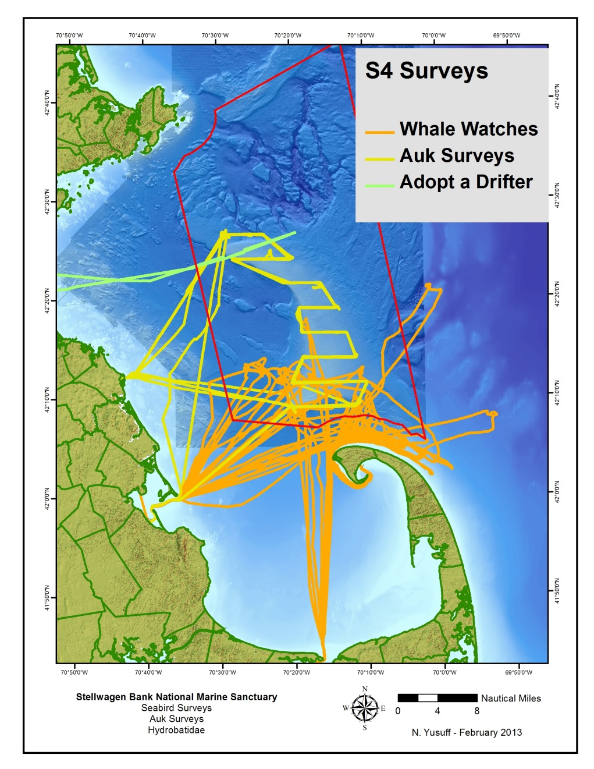
Notes:
There have now been 44 bird surveys since 2011 when the stewards program was started... There are two types of surveys – the standard survey trips run on the Auk, and then more “opportunistic” surveys that take place on whale watch boats, which tend to focus on the southern portion of the bank… the whale watch data we have is somewhat biased towards the southern part of the bank because of the companies/ports we have arrangements with – out of provincetown, banstable, and plymouth. Most of the trips have been in the late summer and fall, again that is when we got the arrangement in place with the whale watch boats.

Slide 7
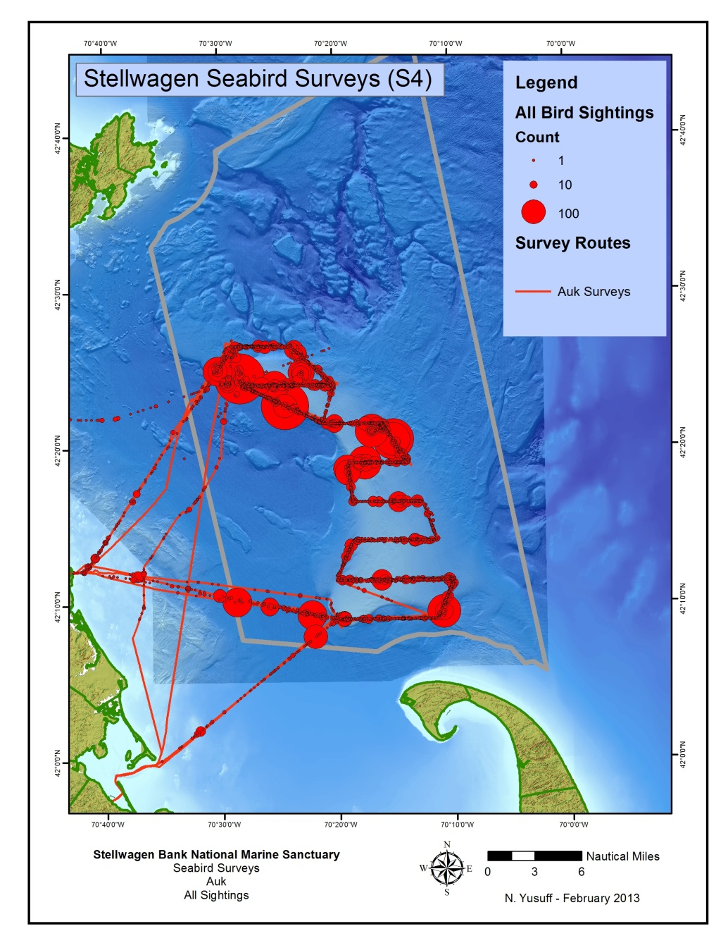
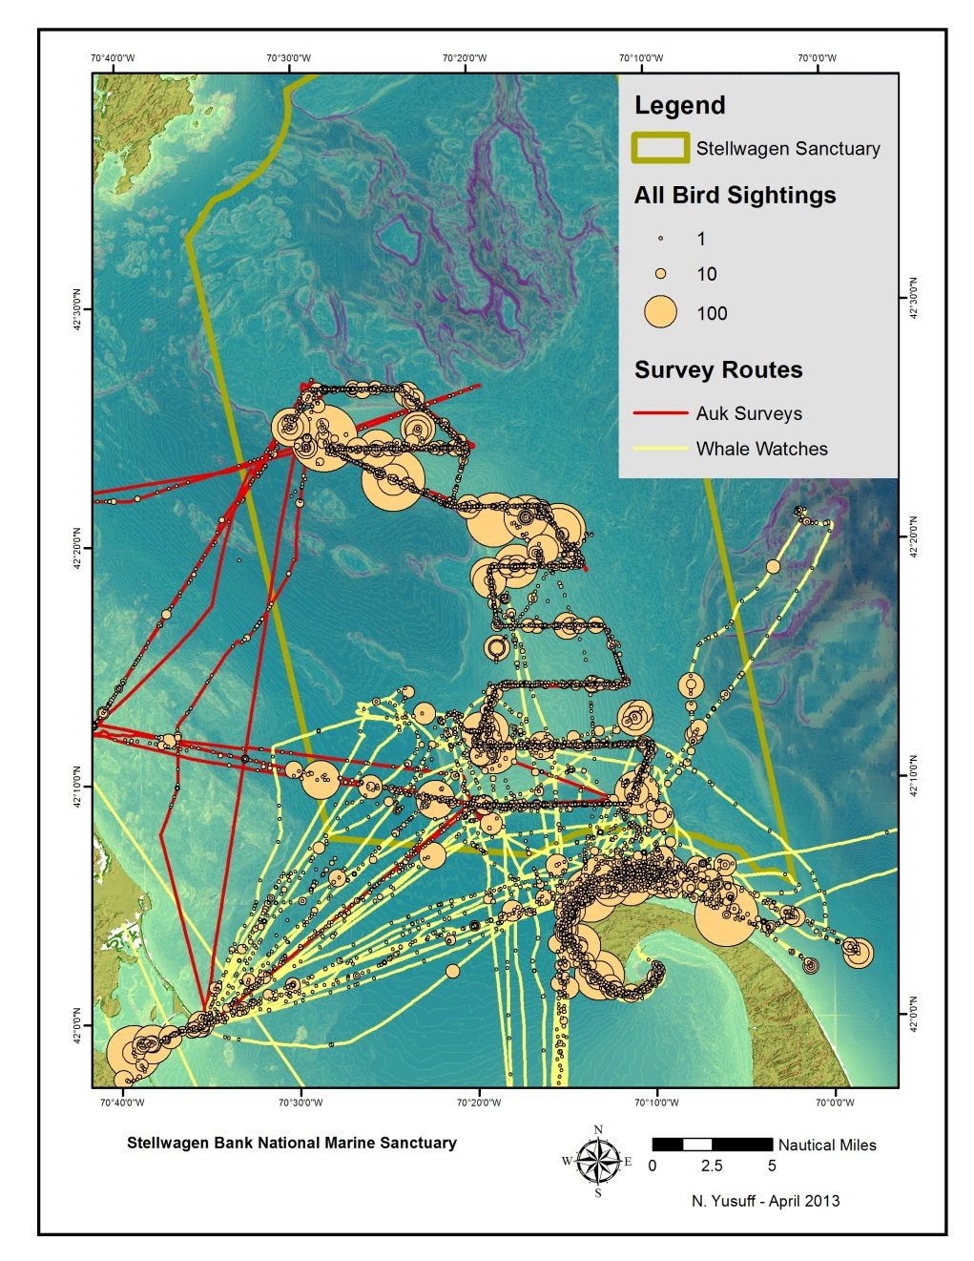
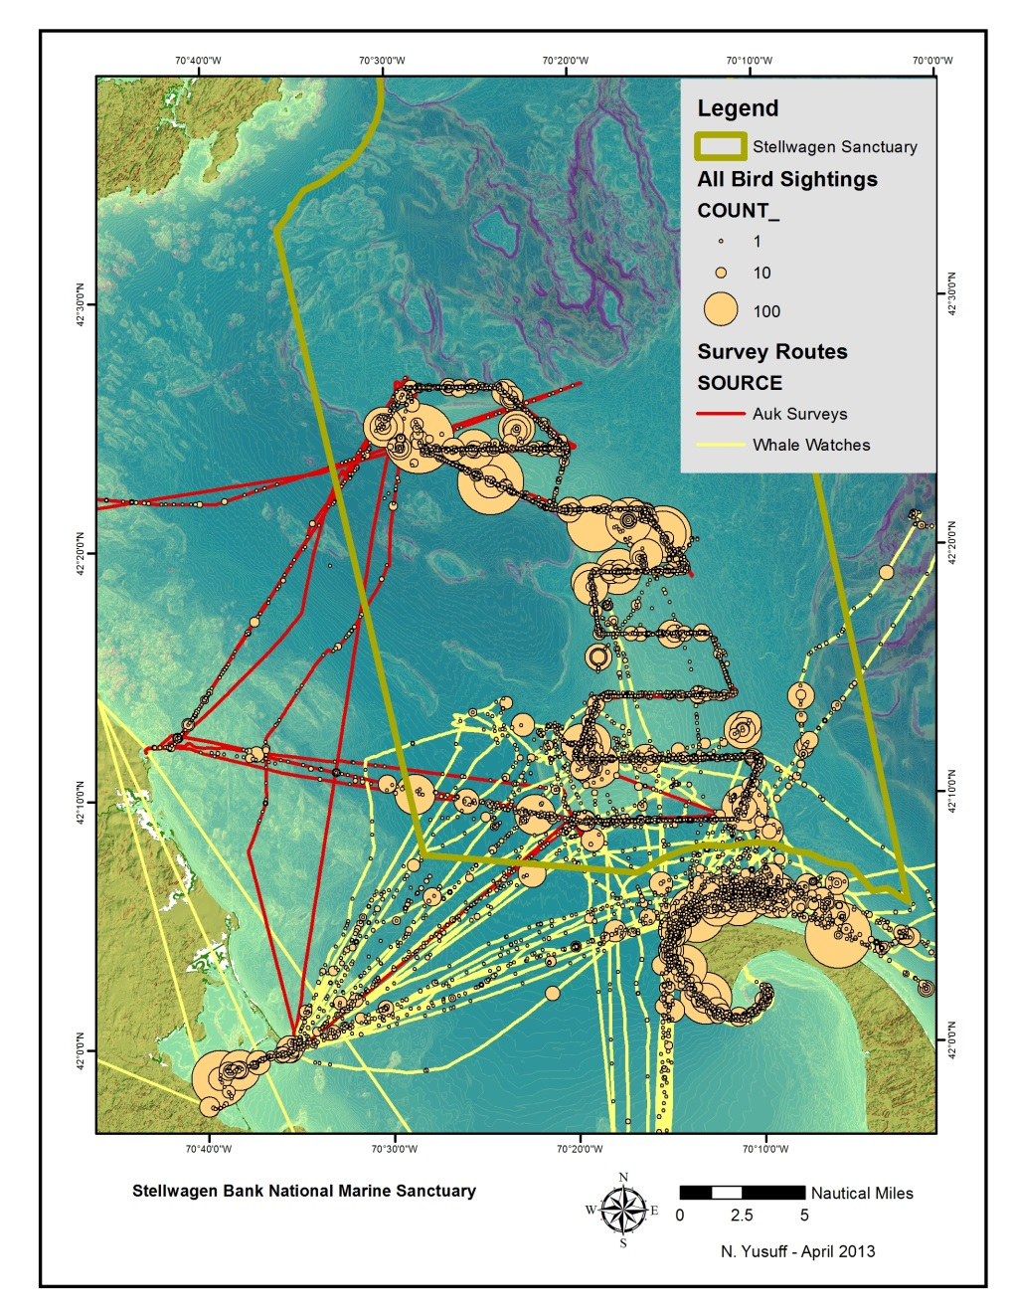
Summary of Data
6764 Sightings of >26,000 birds
59 Species, 18 Families
179 Whale sightings
37 Notable fish sightings
19 Seal sightings
12 Butterfly sightings
>2500 Nautical Miles traveled
44 Survey/Whale Watch trips
Notes:
All sightings on trips – size of the blob is proportional to the number of birds seen. There are some really large congregations of birds – especially gulls and diving ducks that are seen (especially in the winter) – up to several hundred individuals. Also, a lot of sightings off of race point- partially because it’s closer to shore so gets more gulls, and also because it is very heavily surveyed on all the whale watches out of provincetown

Slide 8
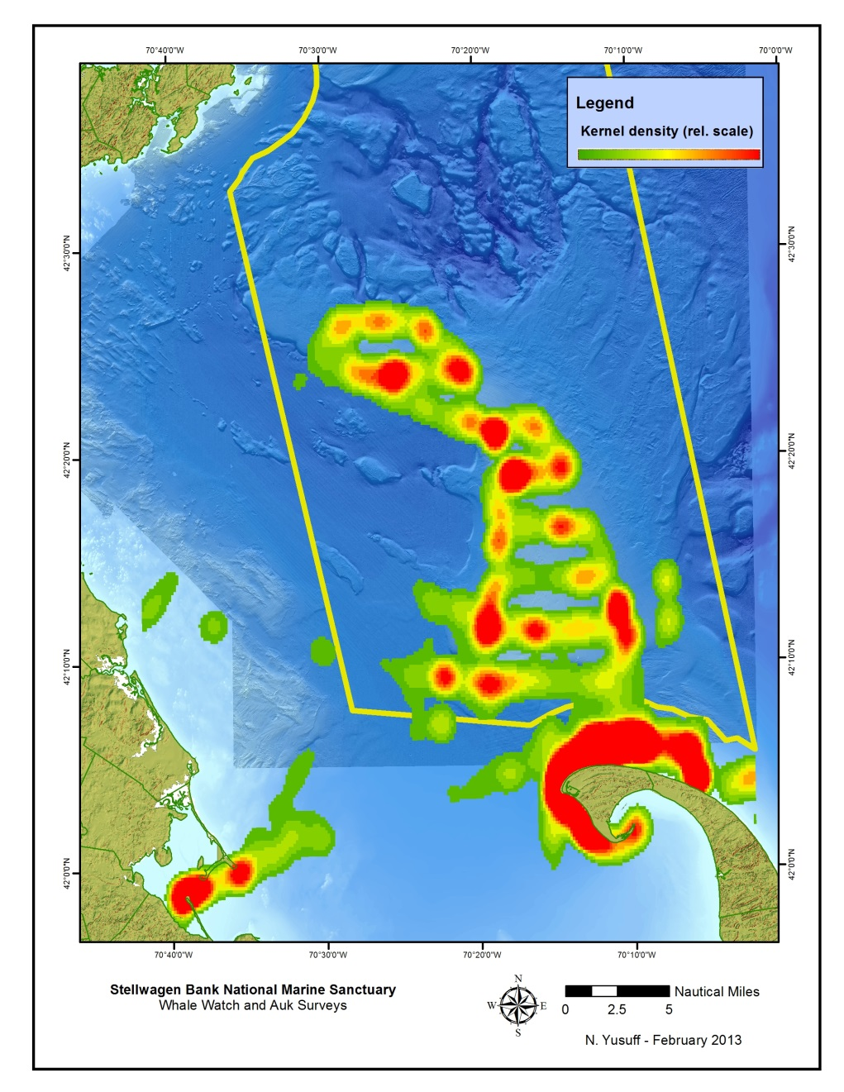
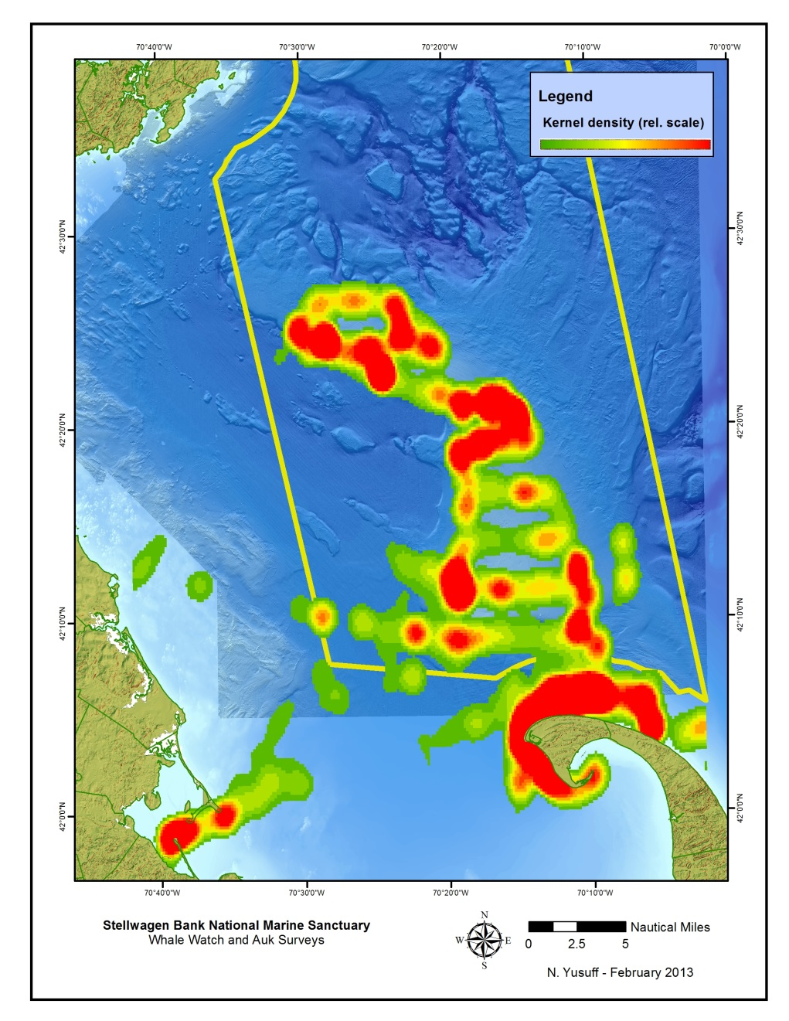
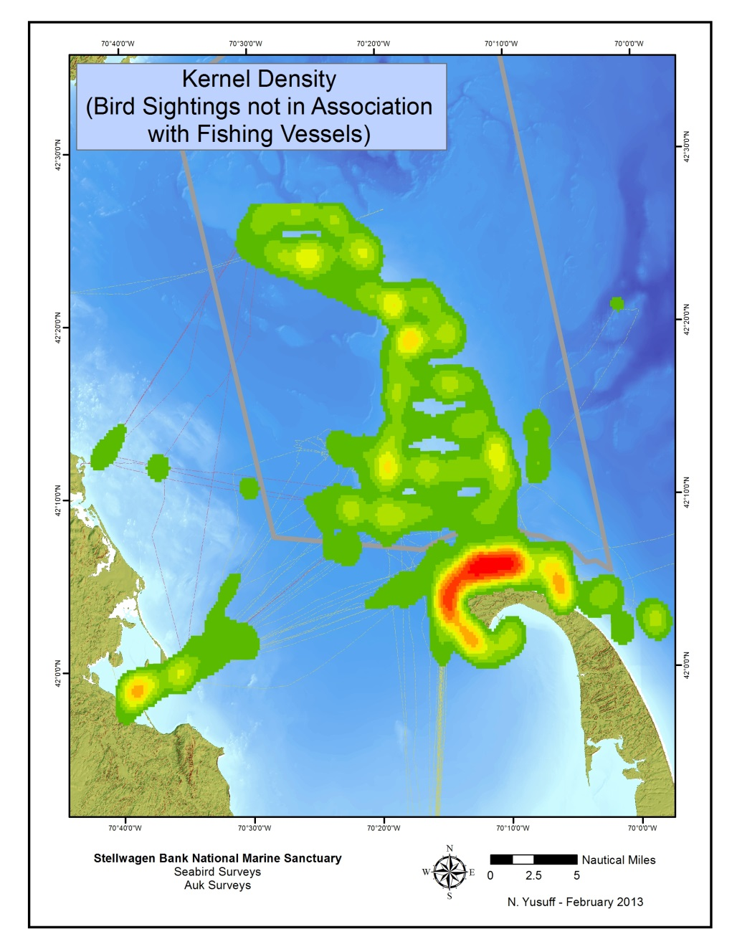
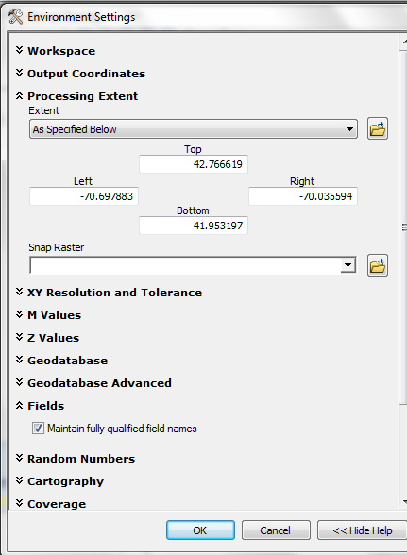
All Sightings
All Sightings
not in Association with Fishing Vessels
Notes:
Kernel density calculation of all sightings gives a heat map type of presentation, again wit large concentrations of birds around race point. Since the bird monitors note associations – you can take out the birds associated with fishing vessels some of these really big blobs dissapear.

Slide 9
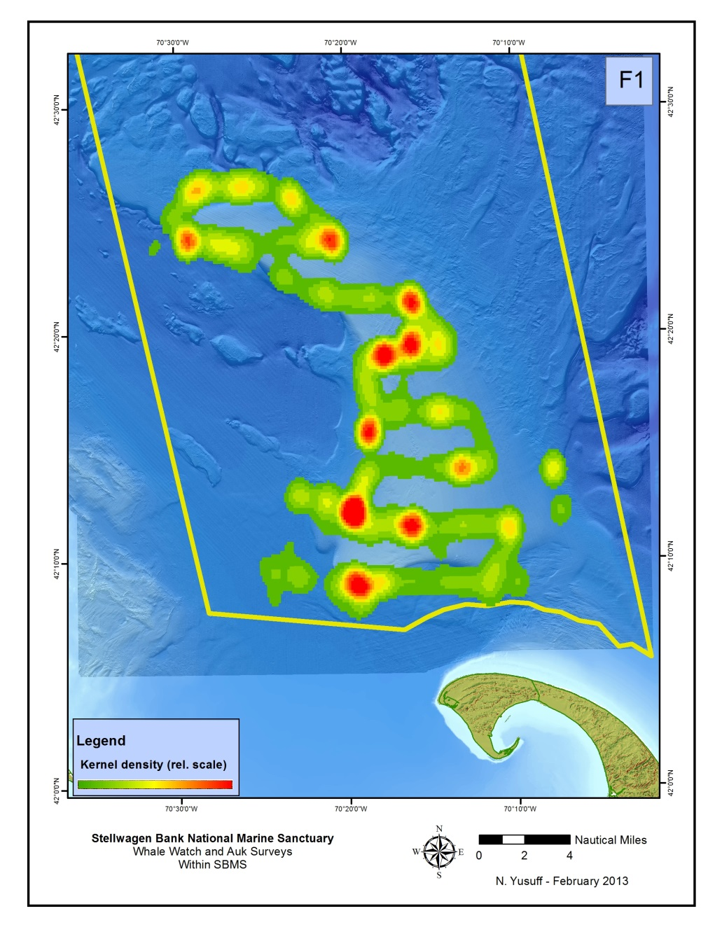
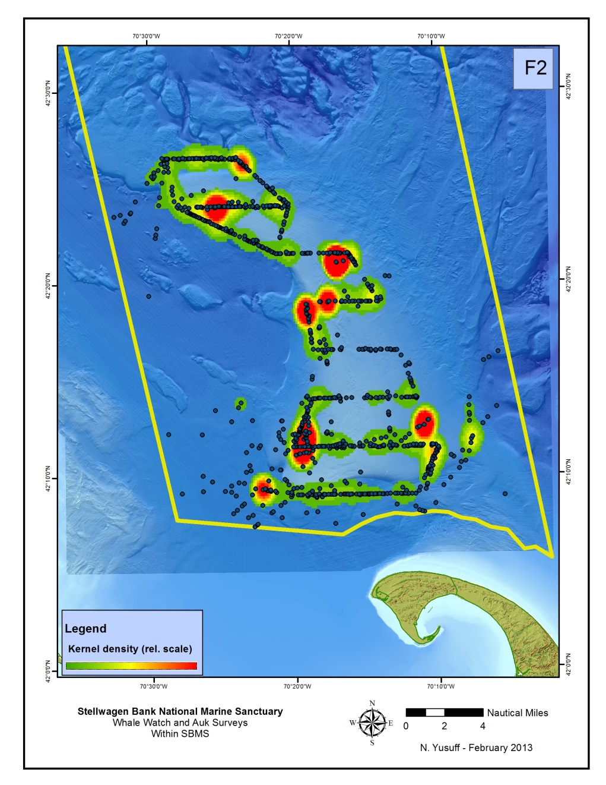
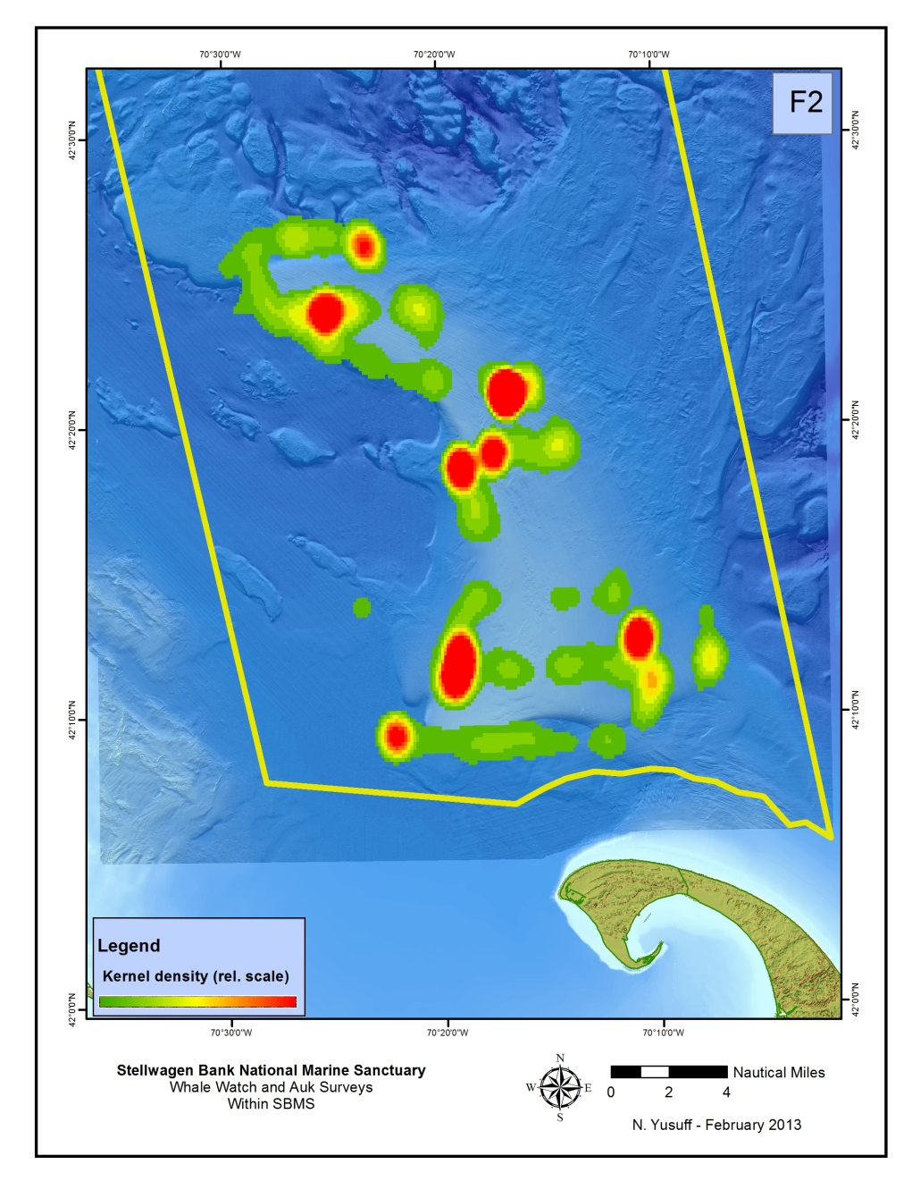
Flying
Sitting
Notes:
F1 = Flying, F2 = Sitting
This is pretty interesting, it is the heat maps of all bird > sightings in SBMS by behavior and association. > The images are labeled by the behavior code (F1-8) and the > association code (A2 and A6) - there are not many data > points for the other association codes. > > I especially like slide 5 - there are many more birds in > association with fishing boats that there are in association > with whales!

Slide 10
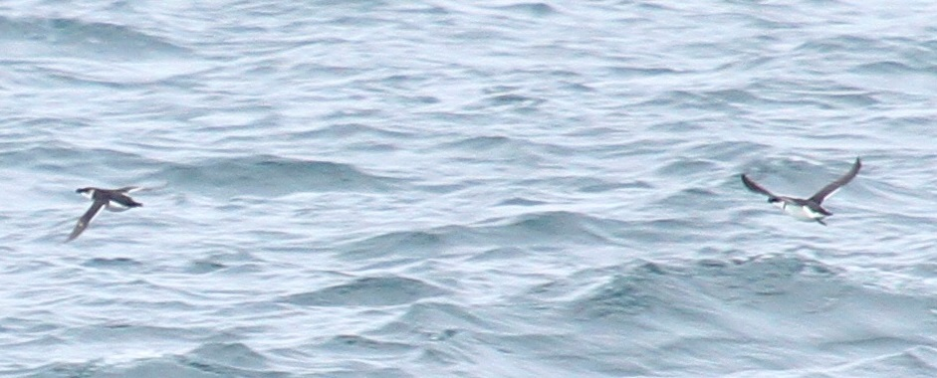
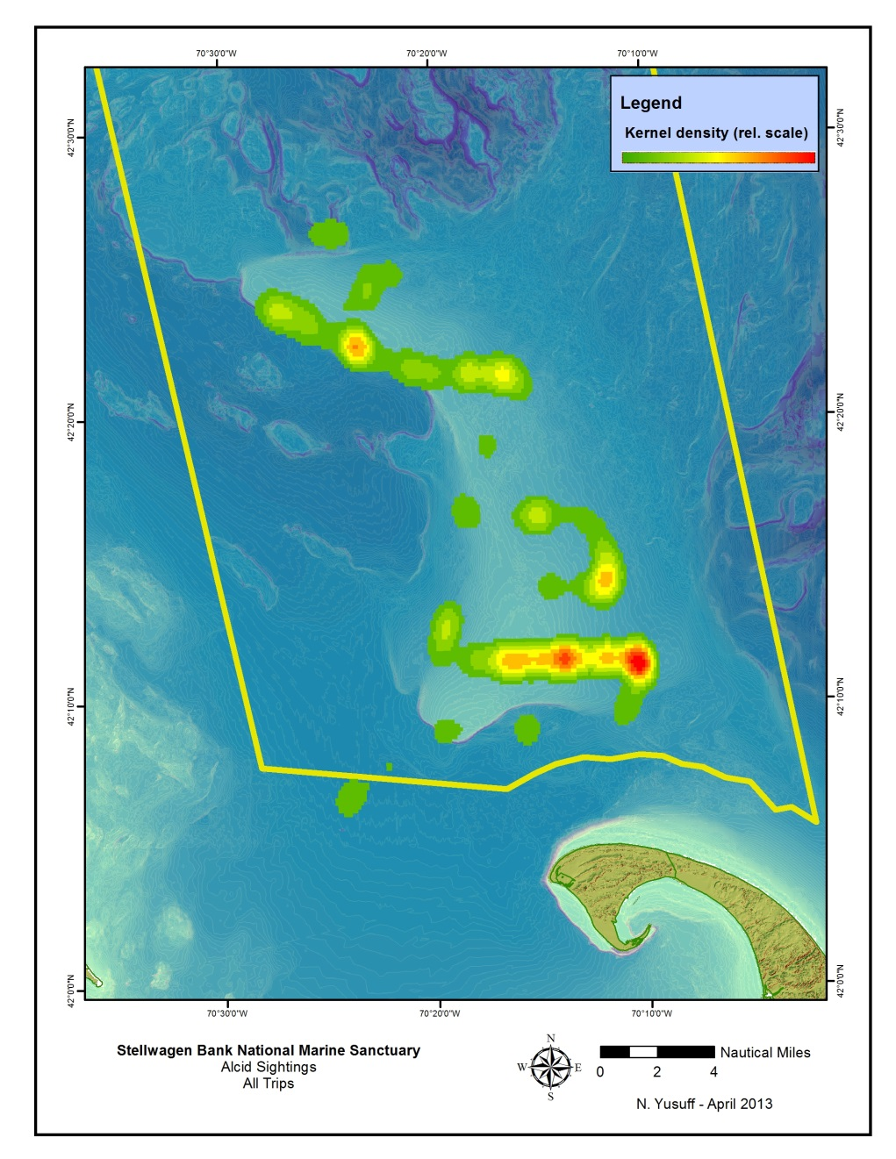
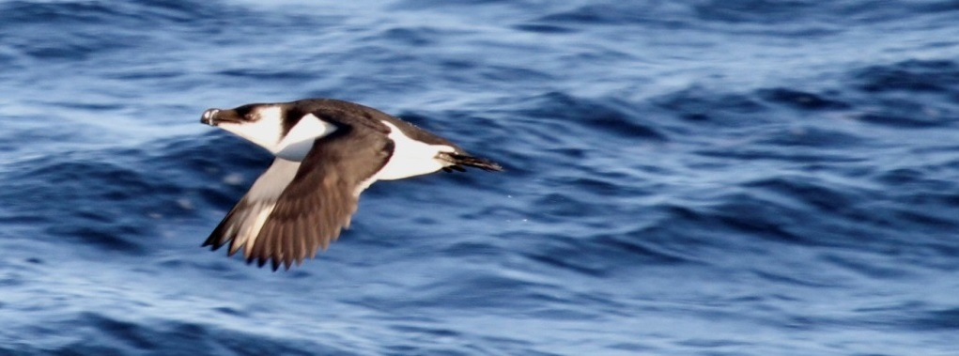
Notes:
Make maps by species or by family – this is a map of Alcid sightings. Alcids are the northern hemisphere equivalent of penguins (except they can fly), black and white birds, great diving birds that eat fish. This is a family that bird watchers get excited about, they are hard to see from shore except after a gale. This is a razorbill, these two are common murres. This is more typical view that you get on the boat – black and white blurs flying by. Interestingly, alcids are not distributed evenly throughout the sanctuary – there are hot spots in the south as well as the northern portion of the bank.

Slide 11
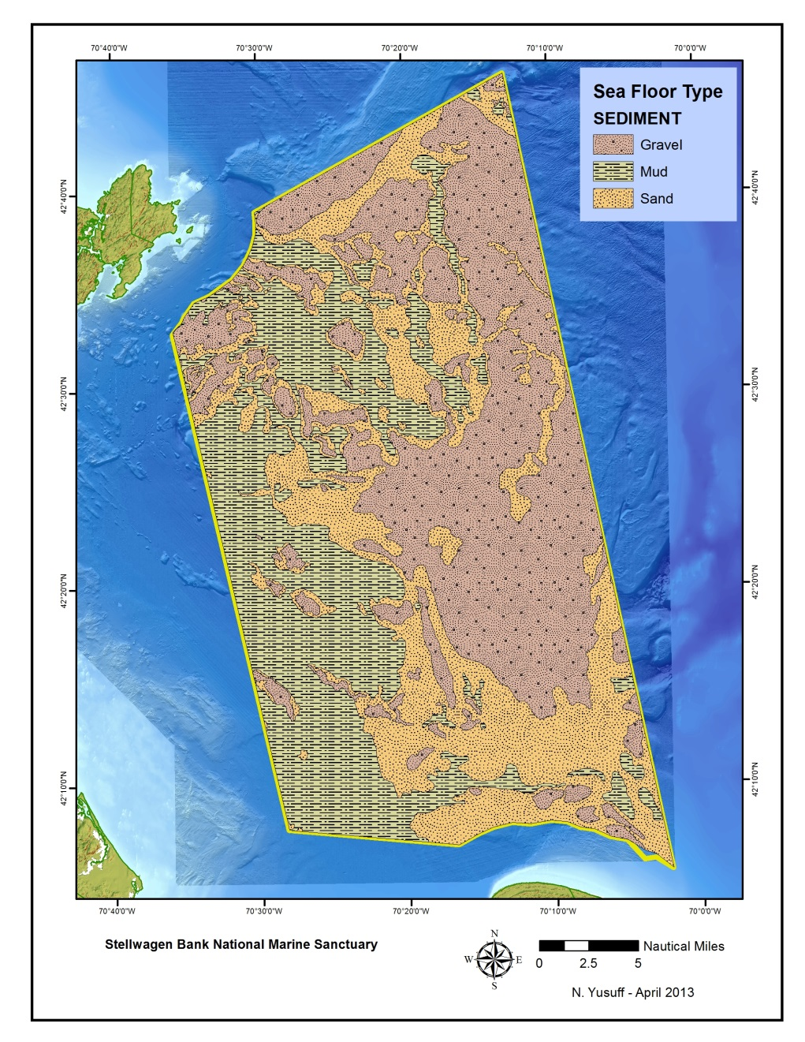
Stellwagen Seafloor
Sand
Mud
Gravel
Seafloor in the sanctuary is about
equal parts sand, mud and gravel.
Notes:
One question that we wanted to ask is if the bird sightings we were seeing were correlated to the habitat on the seafloor- so we took a map of the stellwagen seafloor, and you can see that the sanctuary seafloor is about equal parts sand, mud and gravel.

Slide 12
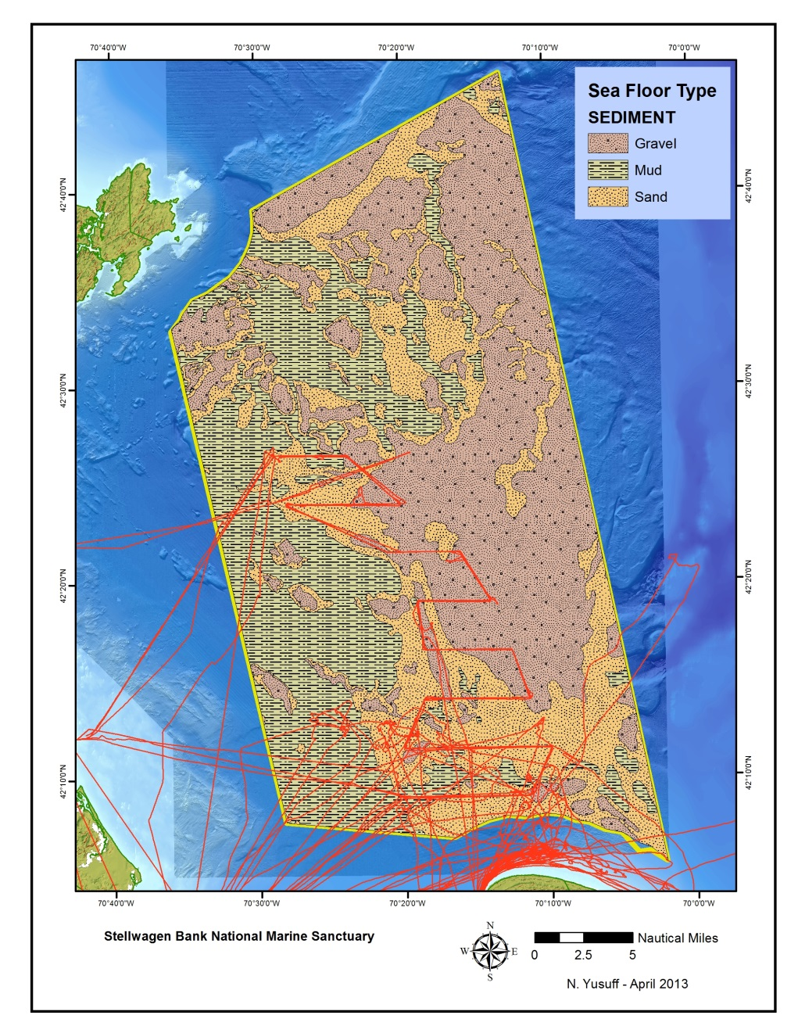
Seabird Survey Tracks
Sand
Gravel
Mud
Seabird surveys over-represent sand and under-represent gravel and mud seafloor habitats.
Notes:
If you take all the GPS points from all the surveys – sand seafloor habitat is somewhat overrepresented,and gravel and mud seafloor habitats are somewhat underrepresented.

Slide 13
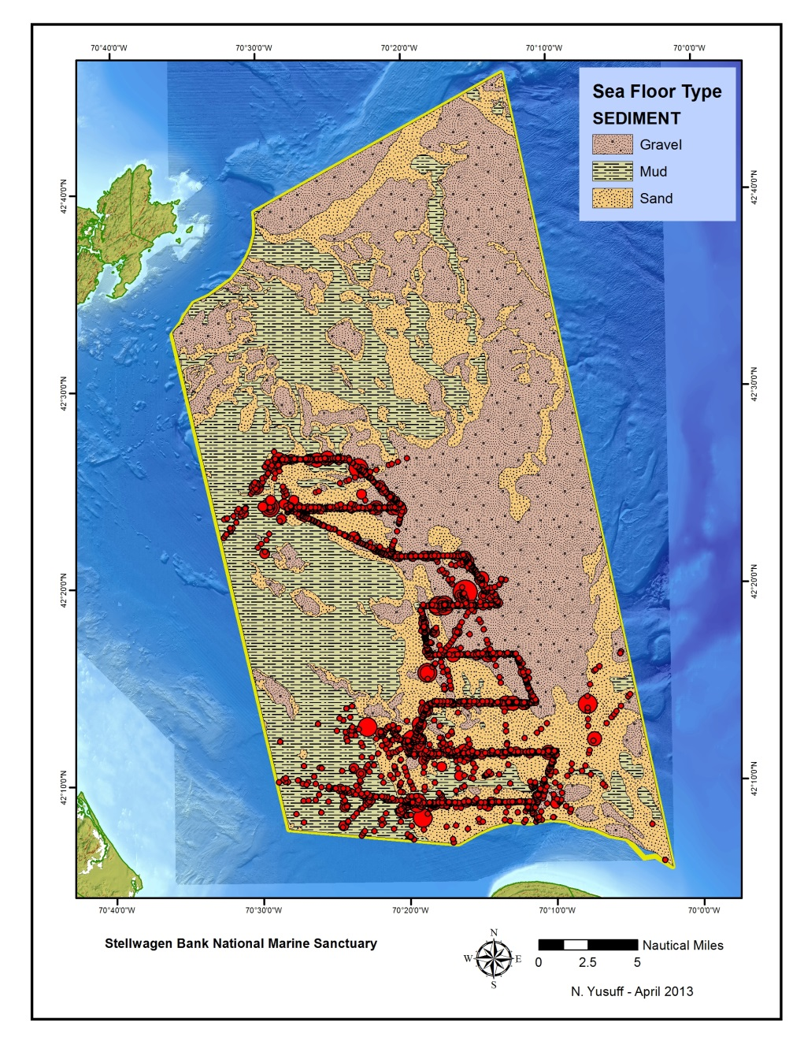
Sanctuary Bird Sightings
Gravel
Mud
Sand
More seabird sightings are over gravel seafloor than expected.
Notes:
Take all sightings and weight them for the number of birds seen – more birds are seen over gravel habitats that would be expected based on the survey routes. This data can be sliced and diced up with definition queries – what does this map look like by species, or family or by removing birds in association with fishing vessels.

Slide 14
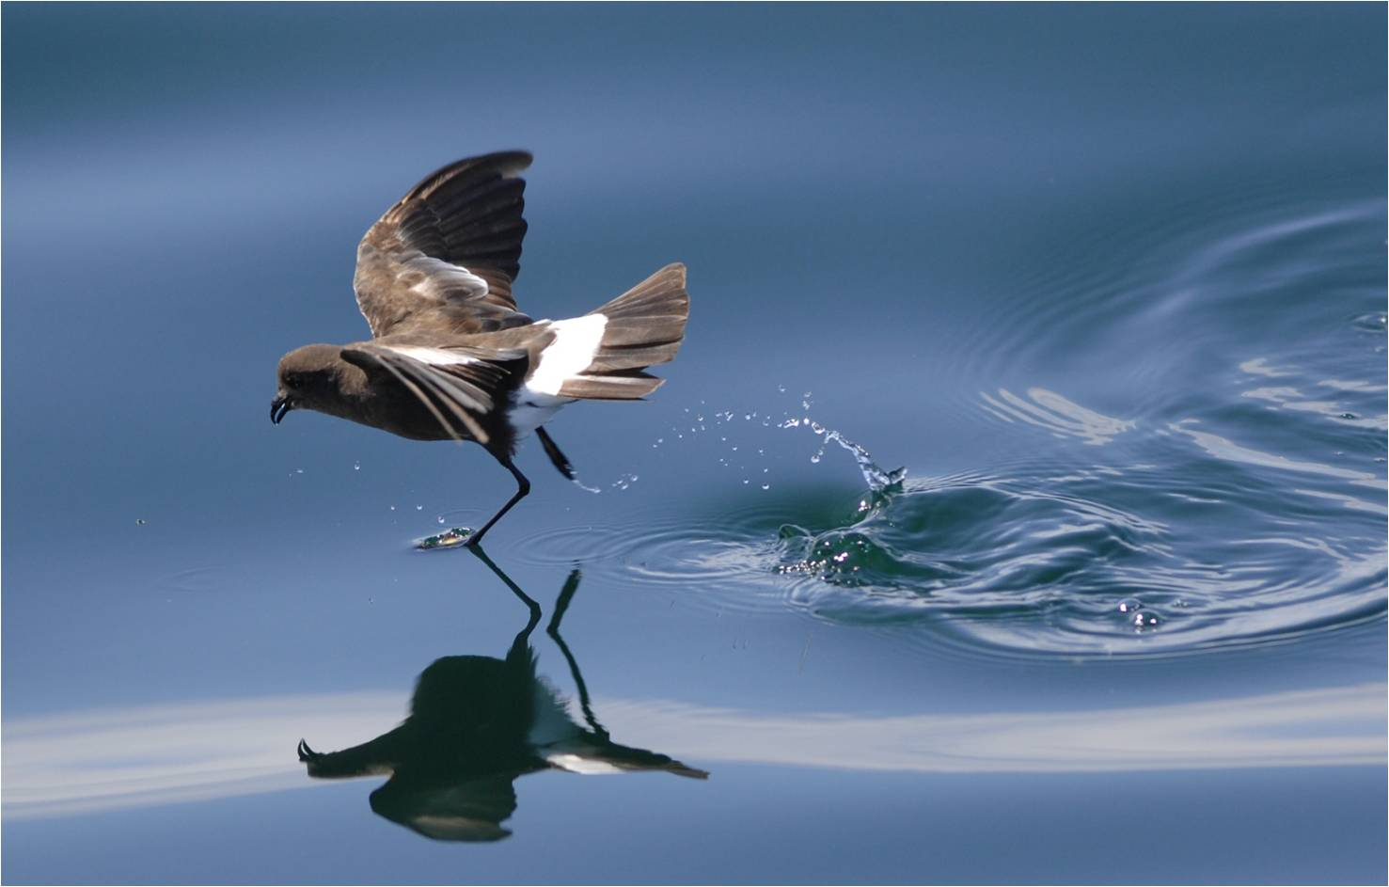
Next Steps
Continue analysis
-Fish & whale data
-Water depth
-Historical data
Compare data collection protocols
Spring recruiting & training
Add 3 more ports for weekly trips on whale watch vessels
Notes:
Challenges – other than funding
Dearth of hypothesis testing projects currently w/ citizen scientists, but larger scale projects could and arguably should involve them.
Next steps:
Update protocol
Recruit/Train current and new volunteers
Evaluate databases
Run 5 Auk Cruises in 2012
Weekly Whale Watch Trips
Report findings
Find funding
Child’s Sanctuary public outreach/ed
Student stewards – train at least two

Slide 15
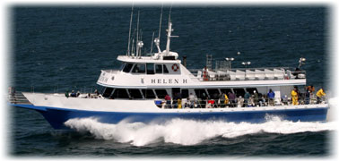
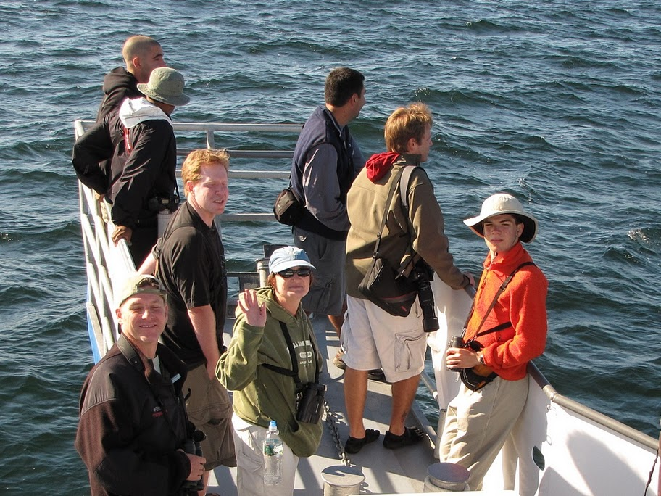
Brookline Bird Club Pelagic Trips
The Brookline Bird Club charters a fishing boat out of Hyannis four times a year to look for pelagic birds. (June, July, August, and November)
Sightings of birds have been recorded on these trips in ½ hour increments and submitted to eBird.
(Thanks to Marshall Illiff)
(photo by Steve Myrick)
The ocean is a big place – where should we go to find the birds?
Notes:
The brookline bird club is a 100 yr old club of amateur recreational birdwatchers – I am on the board of directors and have been particularly involved in organizing pelagic trips to see seabirds. We charter a boat out of hyannis four times a year. We charter the boat, and we’re standing at the dock and the question is where should we go? The ocean is a big place and it is largely gray, flat and featureless. Use historical records – we have sightings data going back to 2009 in ½ hr increments.

Slide 16
`
Notes:
One area that we want to target is the continental shelf edge – broad continental shelf a couple of hundred feet deep, then the water depth drops off pretty rapidly to thousands of feet deep. In addition there are steep canyons at the shelf edge, which are ecologically very rich, there is upwelling of the water in these canyons and mixing, you encounter species in these deep waters that you don’t find closer to shore – for example sperm whales.

Slide 17
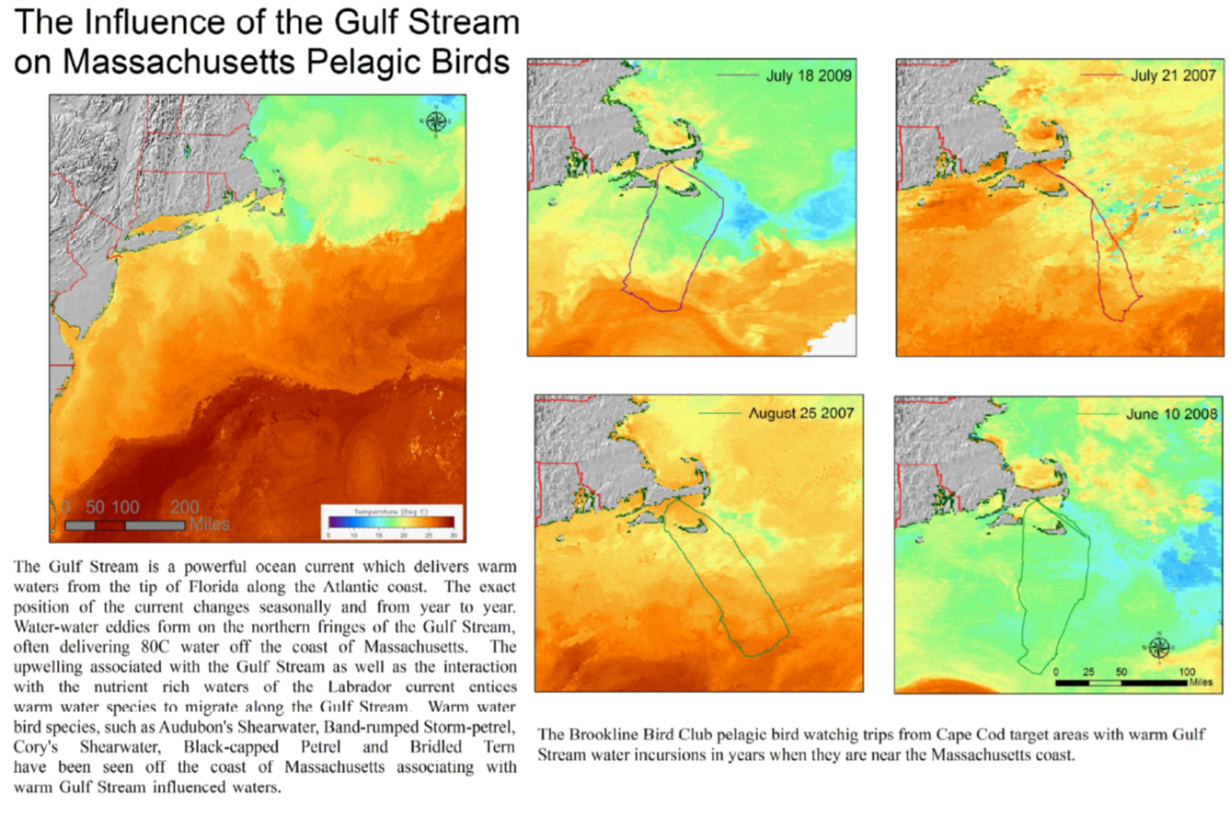
`
Notes:
The gulf stream is an important factor as well – warm water that comes up the atlantic coast. It’s pretty remarkable – boston harbor the water is 50 degrees or so, but if you go 100 miles off shore you get to 80 water. And it looks completely different – the green nearshore water that is rich with plankton is replaced with the clear azure waters that you expect to see on a poster of hawaii or something. The gulf stream itself doesn’t really get all that close to MA, but there often are warm water eddie that swirls up and can get to the shelf edge. The gulf stream is highly variable from year to year, and we often try to target the warm water. Some times the warm water is just not around and you can’t get to it…

Slide 18
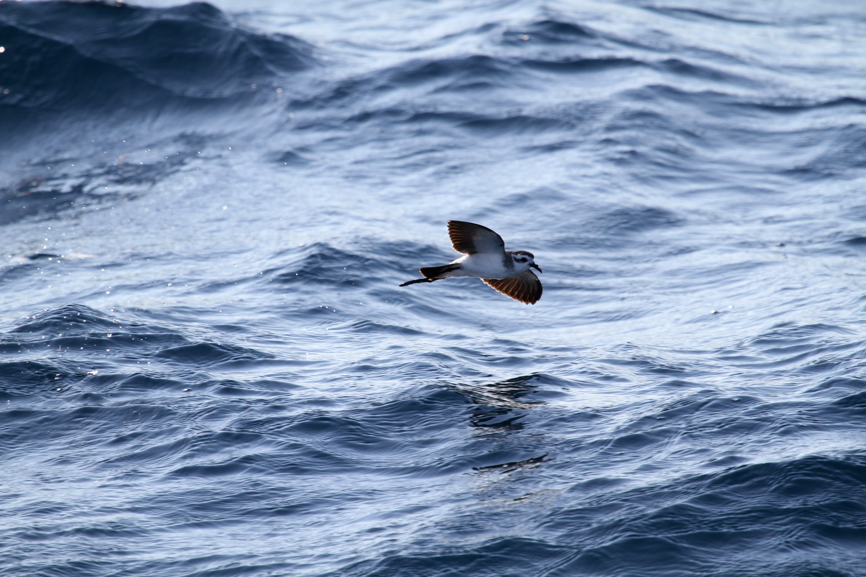
Notes:
This is pretty much the holy grail for birders – this bird is called the white-faced storm petrel, it’s nickname is “the grey ghost” of the atlantic. The bbc trips have had pretty good luck finding these guys, and we may have figured out where they are and when they are there. So people are really clamoring to get on our trips to see there guys – people get on planes and fly in from all over the country to get on our chartered boats to see this bird.

Slide 19
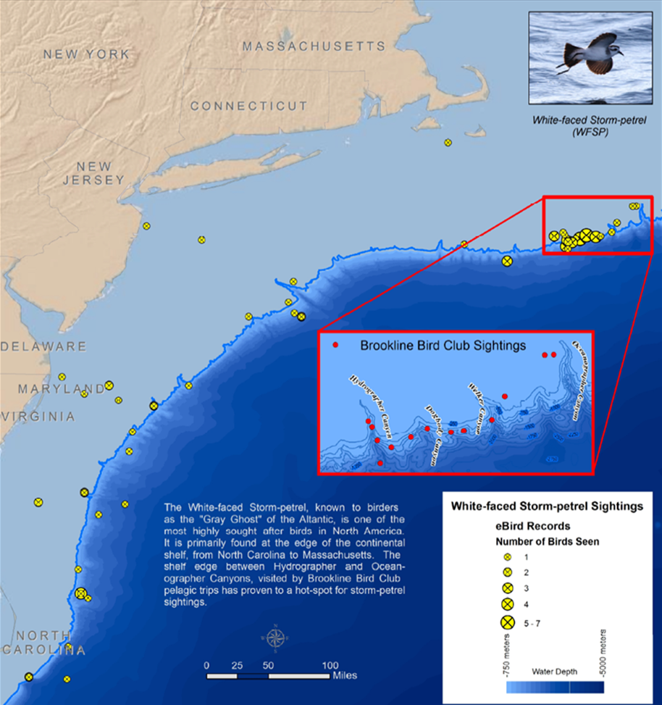
Notes:
This is the data that I pulled from eBird- all the records of WFSP – scattered reports along the atlantic coast – with a real cluster off the coast of MA on the BBC trips.

Slide 20
Notes:
Three summers ago, the route of the trip is shown here, we tabulated seabird sightings every 30 minutes at each one of these grey points – each of the yellow stars is a WFSP sighting. The totals were tabulated by Rick Heil – one of the best birders in the state.

Slide 21
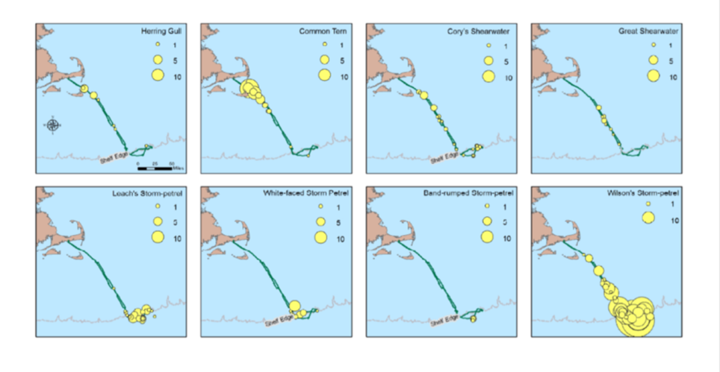
`
Notes:
These maps show summary by species, and the interesting thing is that there are clear trends for where certain birds are found – terns and gulls are really near shore species – wilson’s storm petrels are found throughout, with higher numbers further off shore. Some species are exclusively found in the deeper water- Leach’s storm petrel, band rumped are found in deeper water and in association with warmer water. As well as the WFSP.

Slide 22
`
Notes:
Last summer – Aug 2012 we had a trip for the ages, every shearwater and storm-petrel that have ever been seen in MA were seen on that trip. It was interesting because it really highlighted that this area of the shelf edge is the place to go for WFSP, as well as some other really amazingly rare sightings. There were two interesting areas – the shelf edge of course, but then also the really sharp temperature break between cold water over the nantucket shoals and the gulf stream.

Slide 23
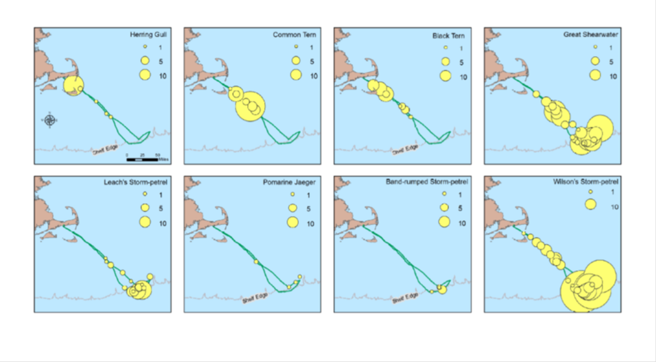
Notes:
We encountered some really massive flocks of common terns and grsh. Similar trends with other species that we observed – LESP, BRSP, WISP…

Slide 24
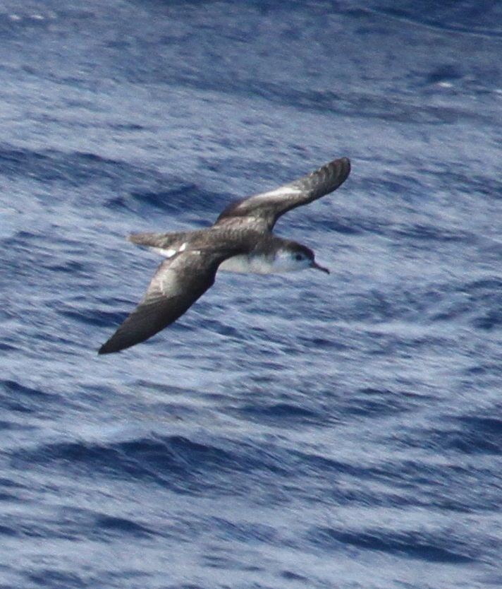
Where should the
Brookline Bird Club go?
Shelf edge
Area with warm Gulf Stream water
Areas with sharp temperature breaks
Barolo Shearwater, Oceanographer Canyon
August 26, 2012

Slide 25
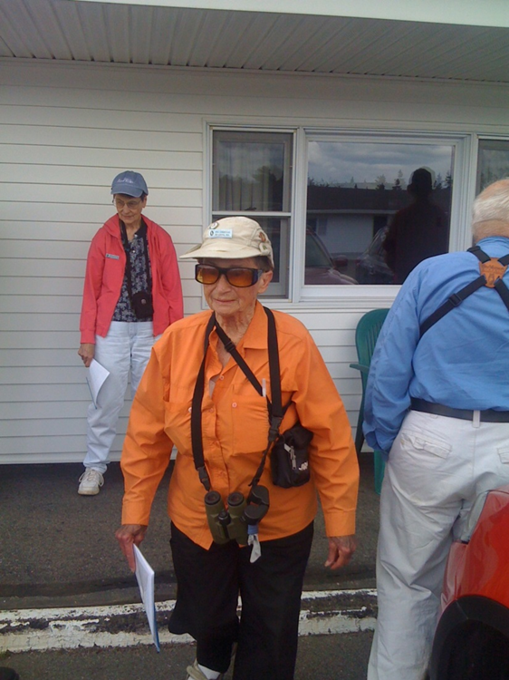
Thanks to the
Brookline Bird Club!

Slide 26
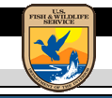
Collaboration
Notes:
Many benefits with collaboration
It takes a village: consultants, education partners, grad students and professors, funders
Data will be shared, used to inform on state of sanctuary, in conjunction with other data to look at forage/prey/other
First grant: $5K from the Nuttall Ornithological Club’s Blake-Nuttall Fund for equipment and supplies for program

Slide 27
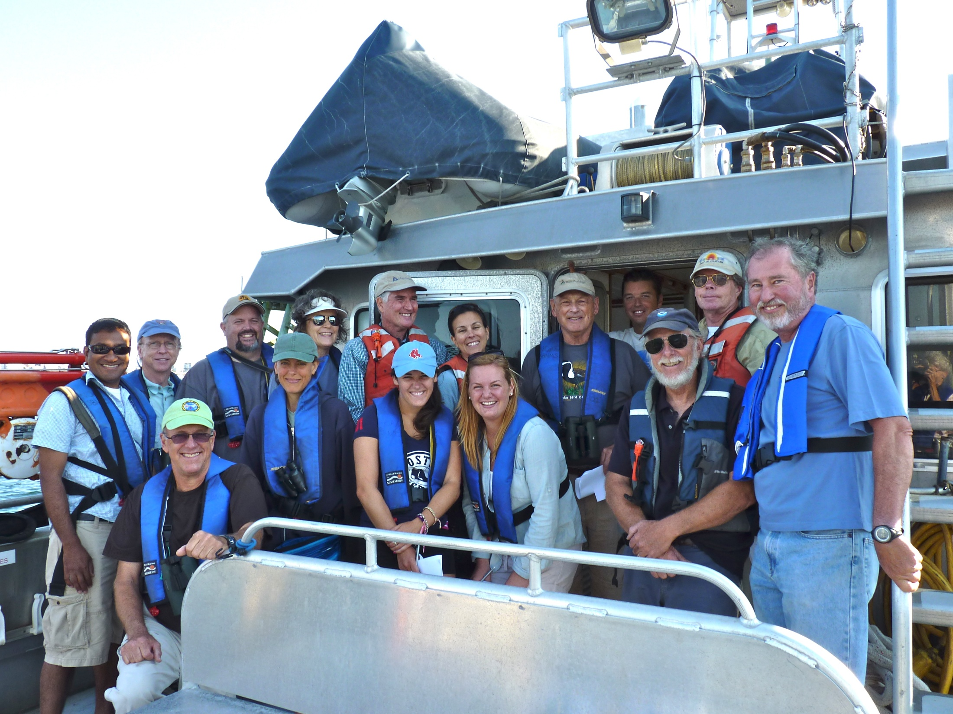
Naeem.yusuff@yahoo.com
Photo: Evelyn Ganson
Notes:
I look forward to your feedback, ideas, funding opps, etc. Questions?

