Slide 1
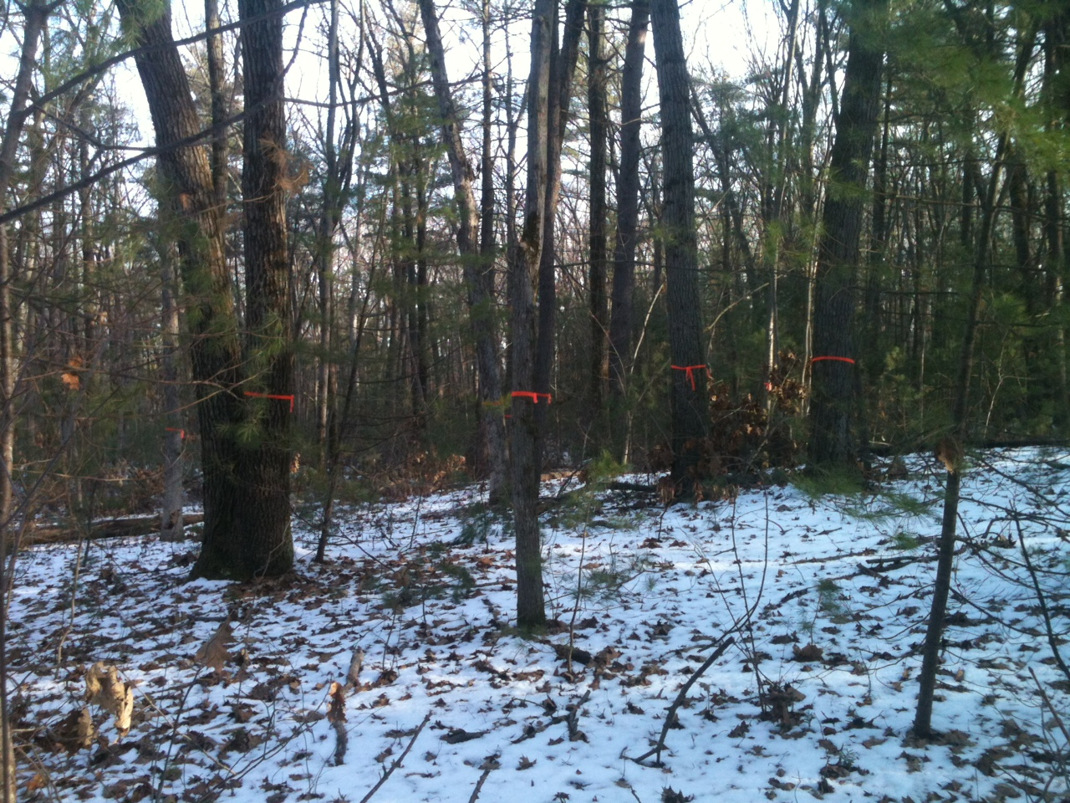
Forest Biomass Estimates Using AIMS Profiling Lidar and Imagery
Danelle Laflower
Mount Holyoke College
Honors Thesis Research
May 2012

Slide 2
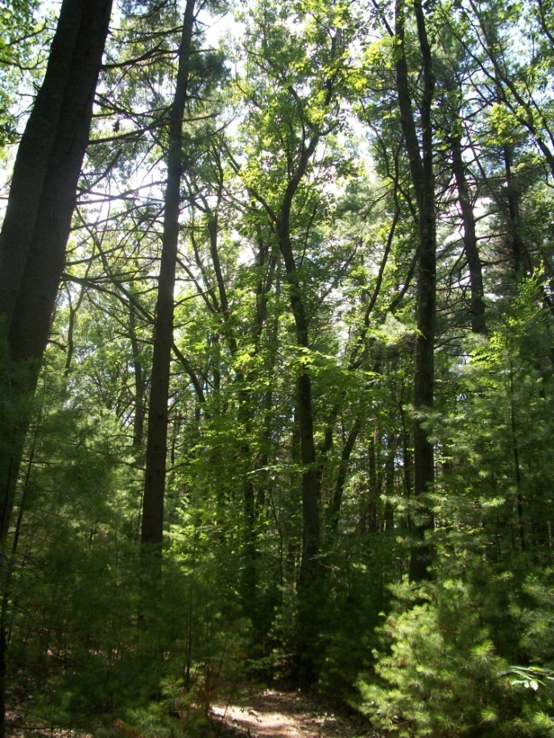
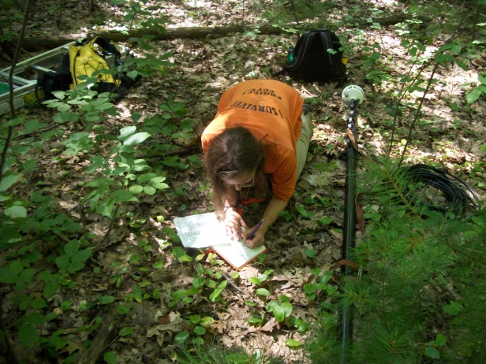
Outline
Objective
Background
Height
Biomass
Conclusion

Slide 3
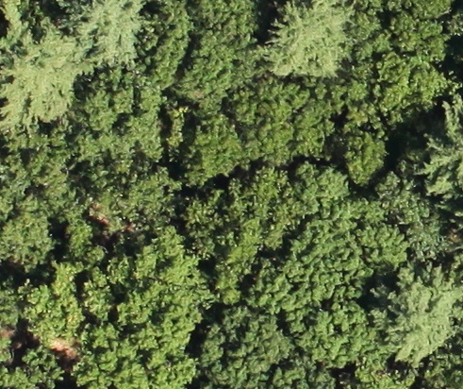
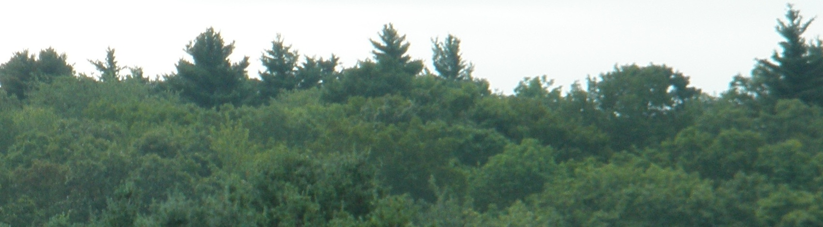
Project Objective
Estimate
  Stand-level biomass:
    Remote sensing
    Ground data
Compare results
Why?
Notes:
-Knowing forest biomass is necessary to having accurate carbon accounting and budgeting, and developing sequestration strategies.
- Profiling lidar data could increase both ease of obtaining data and cost-efficiency.

Slide 4
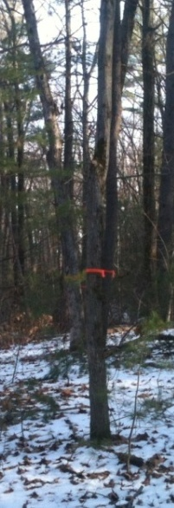
Biomass
Allometric equations
Red Oak aboveground biomass(Mg)=
((EXP(-2.972+-0.017*dbh+2.873*(LN(dbh^1))))*0.001)*1.05
→Remote data as surrogates
Notes:
Allometry- “relative growth in part in relation to an entire organism” Empirical equations obtained by measuring characteristics (dbh and biomass) and using regression to estimate the relationship

Slide 5
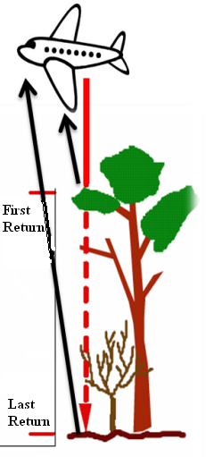
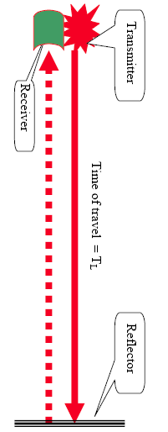
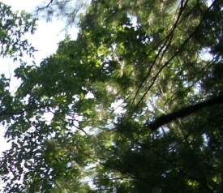
What is Lidar?
An acronym: Light Detection And Ranging
Measures distances
  Laser pulse
  travels at the speed
  of light
  Time is converted
  to distance D=ct/2
Notes:
A laser pulse is sent from the transmitter; it travels in a straight line until it hits a target; then it is reflected back and the time traveled x the speed of light is divided by 2 to get a distance measurement. ***Software records precise Time stamp and location when the pulse is fired and when it returns. Dual return lidar measures a first and last return. In pulsing lidar, only the peaks are recorded.

Slide 6
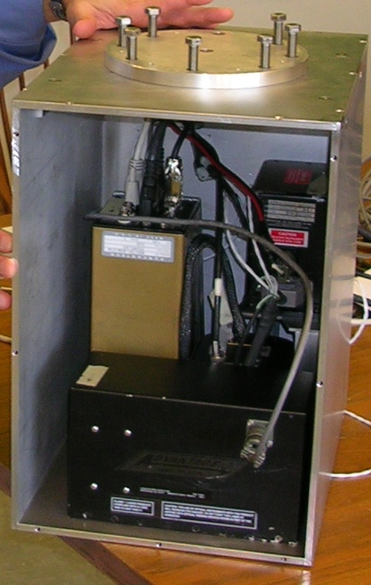

AIMS Sensor
Airborne Imaging and Multispectral System
AHRS
High resolution camera
Lidar
GPS
Computer
http://pugetsoundlidar.ess.washington.edu/laser_altimetry_in_brief.pdf
Notes:
Power is in the lidar and imagery referencing to a coordinate system- due to computer timestamp of all components. Laser:
wavelength 905 nm
fired ~240 x/sec
Up to 5-6 lidar points/m at plane speed ~90 mph
Dual (first and last) return lidar

Slide 7
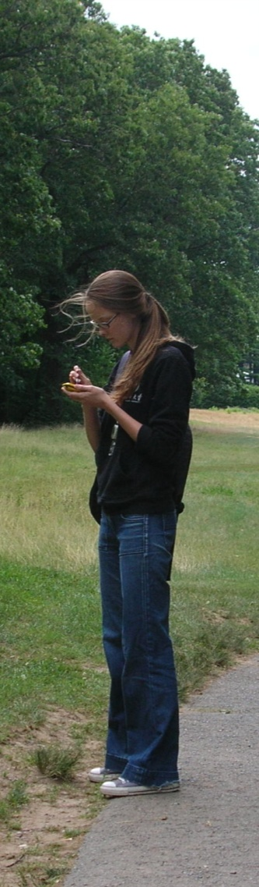
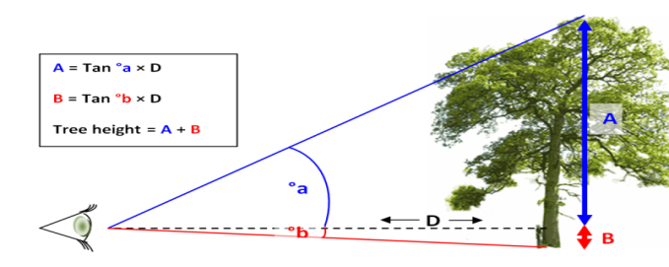
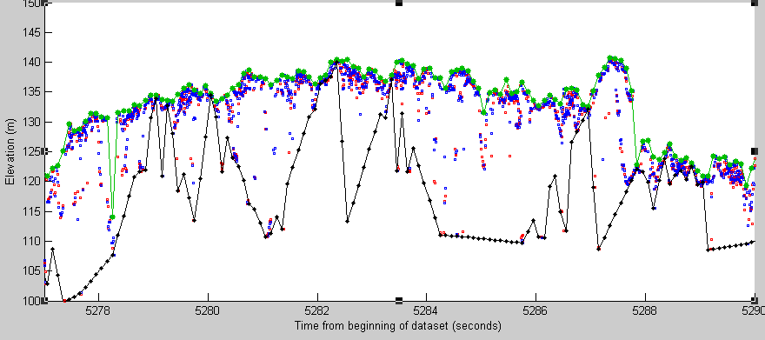
2010 Summer Research Project
Estimate transect heights
  Lidar measurements
Verify with ground data
http://sylva.org.uk/oneoak/images/trigonometry.PNG
Elevation
Time
420 m

Slide 8
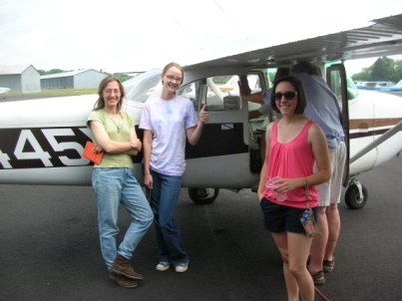
Remote Measurements
Flew AIMS over 5 transects
  Cessna 172
  ~300m elevation
  ~145km/h
    Heights
    Images
Notes:
~12 points/sec = Up to 5-6 lidar points/m and one image every 60-70m

Slide 9

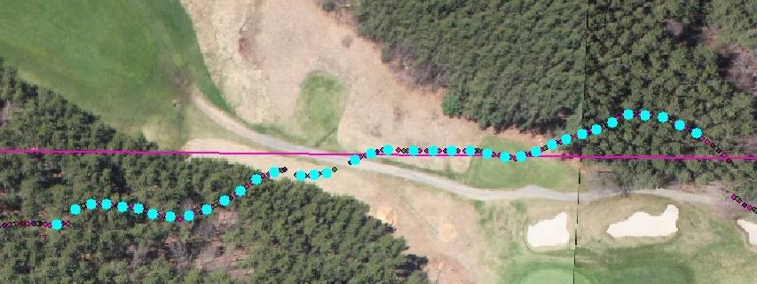
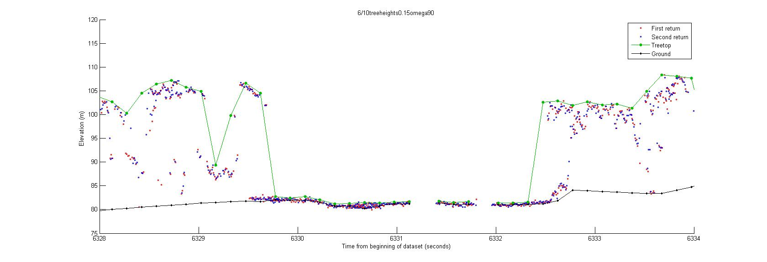
Height:
Lidar processing
www.syntap.com
Canopy height
Time (seconds)
Profiling lidar processed using MatLab Scripts
Notes:
Timestamp allows lidar data to be matched with location data.
which we take to mean the top of the canopy and the ground surface pip software matches data via timestamp matched to gps ground position and ahrs.

Slide 10
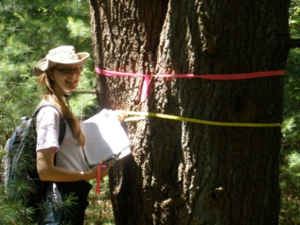
Ground Measurements
Systematic sampling
5 transects-366 trees
  Species
  Canopy
  Height
  DBH
    Distance & azimuth

Slide 11
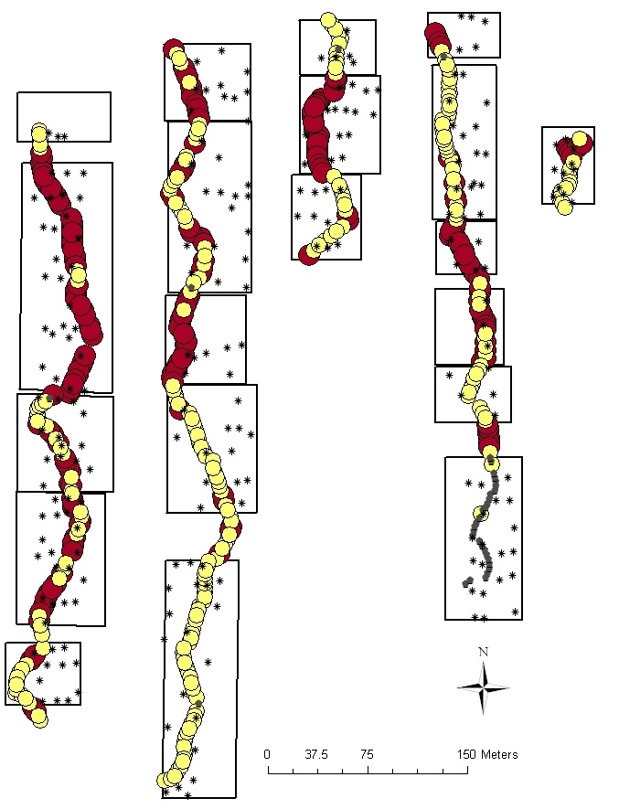
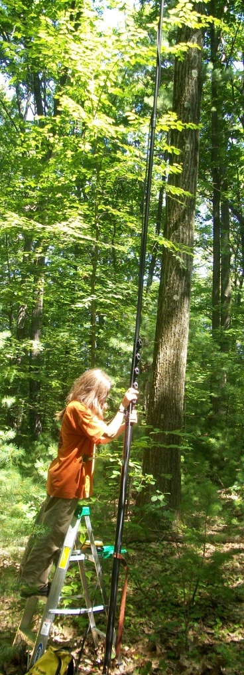
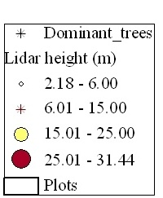
Plots
    Subdivide
    20 plots
    Filter
    236 canopy trees

Slide 12
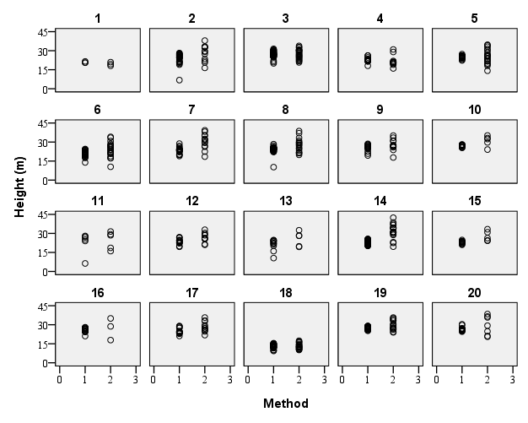

Canopy height data
1=lidar
2=ground (canopy-level trees)
Average ground height= 0.511+(1.096*Lidar height)
R²=0.658, p<0.001

Slide 13
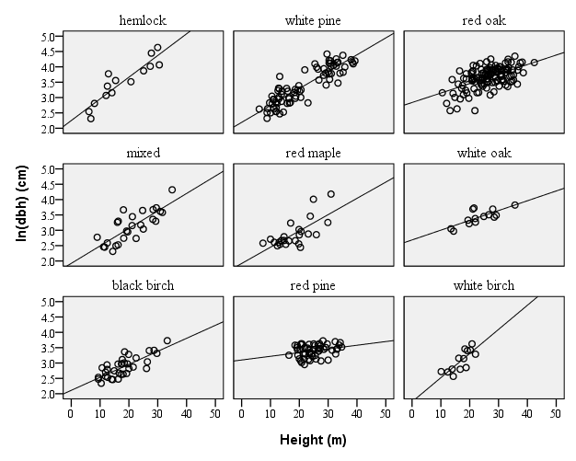
Height to Estimate ln(dbh)
R² by species
White pine =0.782**
Hemlock =0.701**
White birch=0.620*
Black birch=0.600**
White oak =0.572**
Red maple =0.507**
Red oak =0.318**
Red pine =0.078*
Mixed hardwood=.60**

Slide 14
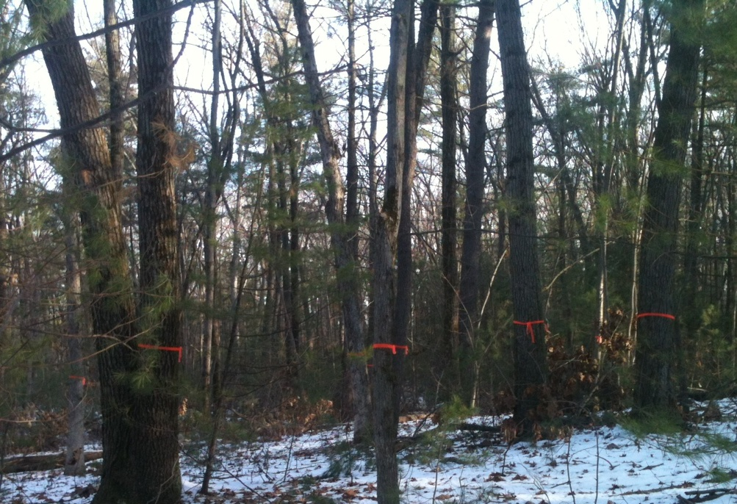
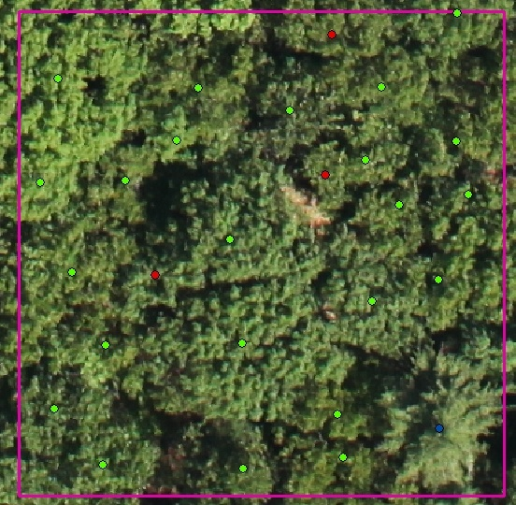
Stand-level biomass ten 30m*30m subplots- scaled to hectare
Remote calculations
Ground calculations
Species
Dbh
Notes:
Matched ground and images by sample tree tag numbers- using ground data as reference.

Slide 15
Calculating Biomass From Ground Data
Identify species
Total plot biomass
Calculate biomass
DBH of each tree
Scale to hectare

Slide 16
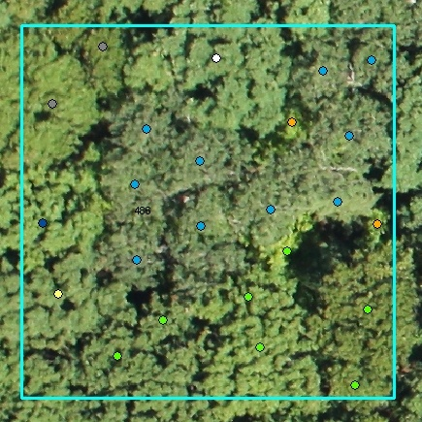
Remote Methodology
Photointerpretation
Identify species
  Texture
  Color
Count stems
  Measure crowns
  Growth patterns

Slide 17
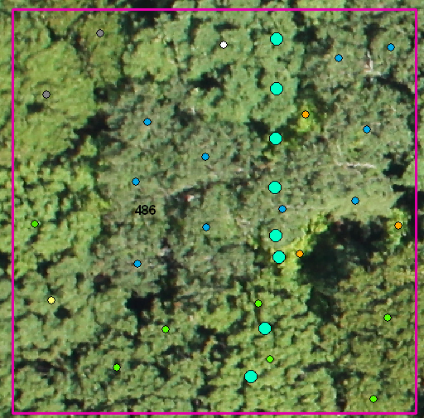
Remote biomass
Plot 486
1 lidar height
lidar height | pred.height | sp | #trees/ sp | stems/ 30x30 | trees/ha | reg lndbh | dbh | biomass | HA sp ttl biomass | total bio/ HA
23.4 | 26.1 | bb | 2 | 24 | 22.2 | 3.208 | 24.7 | 0.360 | 8.001
23.4 | 26.1 | ro | 7 | 24 | 77.8 | 3.649 | 38.4 | 1.000 | 77.742
23.4 | 26.1 | sm | 1 | 24 | 11.1 | 3.396 | 29.8 | 0.738 | 8.195
23.4 | 26.1 | mh | 0 | 24 | 0.0 | 3.412 | 30.3 | 0.401 | 0.000
23.4 | 26.1 | wo | 1 | 24 | 11.1 | 3.522 | 33.9 | 0.551 | 6.126
23.4 | 26.1 | hi | 3 | 24 | 33.3 | 3.410 | 30.3 | 0.585 | 19.485
23.4 | 26.1 | bta | 10 | 24 | 111.1 | 3.396 | 29.8 | 0.318 | 35.304 | 162.602
24

Slide 18
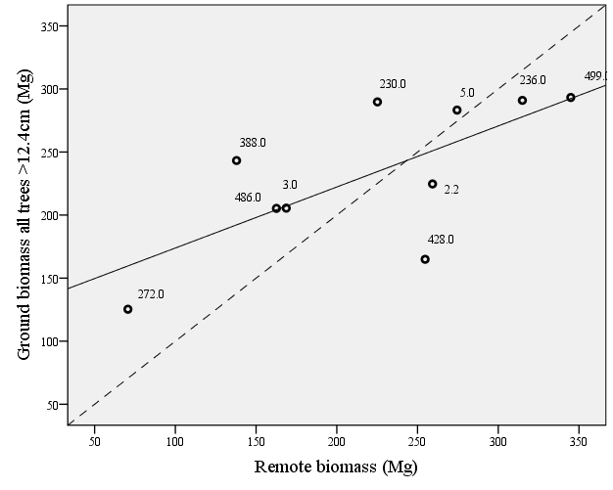
Biomass
biomass=
125.492+(0.484*remote biomass estimation)
R²=0.499, p=0.022

Slide 19
Methodology test
Red bars = data that reflects actual stem density or %red oak (R²=0.74)

Slide 20

Conclusions
We can:
  Use lidar to estimate stand height
  Estimate dbh from height (For most species)
To estimate biomass
  We need:
    More data
    Improve consistency

Slide 21
References
Birdsey, R.A. 1992. Carbon storage and accumulation in the United States forest ecosystems. USDA (United States Department of Agriculture) Forest Service GenTech Report WO-59.
Brown, S. 2002. Measuring carbon in forests: current status and future challenges. Environmental Pollution 116:363-372.
IPCC (Intergovernmental Panel Climate Change). 2000. Good practice guidance and uncertainty management in national greenhouse gas inventories LULUCF (Land use…). IPCC Task Force on National Greenhouse Gas Inventories.
Jenkins, J.C., D.C. Chojnacky, L.S. Heath, and R.A. Birdsey. 2004. Comprehensive database of diameter-based biomass regressions for North American tree species. USDA Forest Service Northeastern Research Station General Technical Report NE-319.
Millette and Hayward (2005). Detailed forest stand metrics taken from AIMS-1 sensor data. ASPRS annual conference. Baltimore, MD.
Olson, J.S., J.A. Watts, and L.J. Allison. 1983. Carbon in live vegetation of major world ecosystems. Oak Ridge National Laboratory, Environmental Sciences Division Publication 1997. NCFMP (North Carolina Floodplain Mapping Program). 2003. Lidar and Digital Elevation Data. www.ncfloodmaps.com/pubdocs/lidar_final_jan03.pdf (accessed 12/2011).

Slide 22
Acknowledgments
Thomas Millette
Eugenio Marcano
HHMI
Center for the Environment
Martha Hoopes
Linnea Johnson
Dana Rubin
Paul Laflower
Josh Laflower
David Marcano
Gabriel Marcano
Marshall Laflower
Skylar Supranaut
Erica Moody
Erin Frick
Dean Gamache
Yue Zhao
Janice Gifford
Umass Landeco Stats Advisors

Slide 23
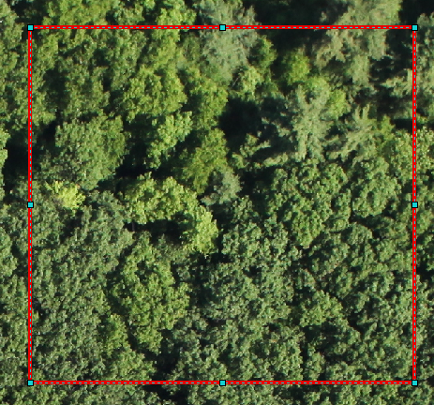
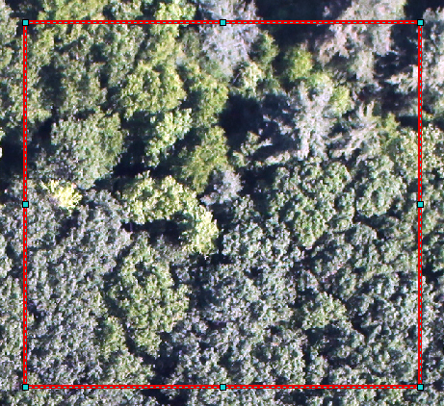
Determine individual trees
Natural color
Standard deviation stretch

Slide 24
Sampling density
Sampling scheme grid pattern over tree ~20-30m tall tree canopy. Dominant canopy stem density ~240 trees/ha. (21 trees)
Sampling scheme grid pattern over ~14m tall tree canopy. Dominant canopy stem density >1000 trees/ha.
(131 trees)
Notes:
If the tree heights were more variable, this sampling density would not be adequate.

Slide 25
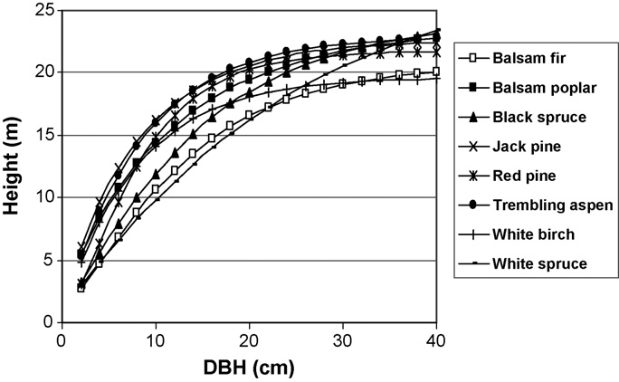
Red pine height to dbh relationship
My trees range from 16-34m tall and 19-41cm dbh
Normally, mature red pines are about 21 to 24m tall, with d.b.h. up to 91 cm silvi manual
Shama, M. and J. Parton. 2007. Height-diameter equations for boreal tree species in Ontario using a mixed-effects modeling approach. Forest Ecology and Management 249:187-198.

Slide 26
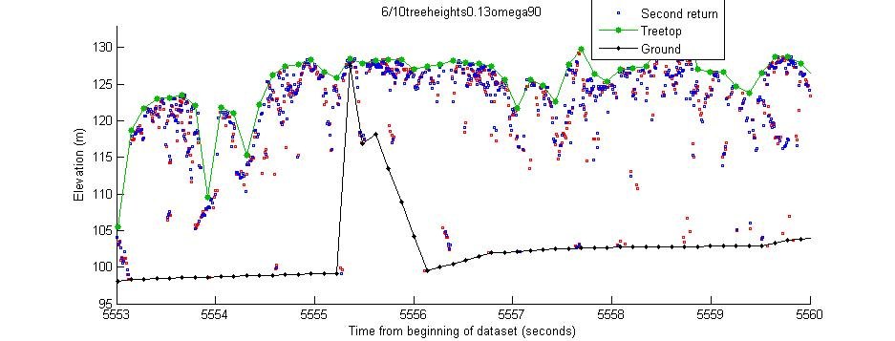

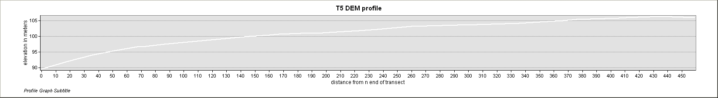
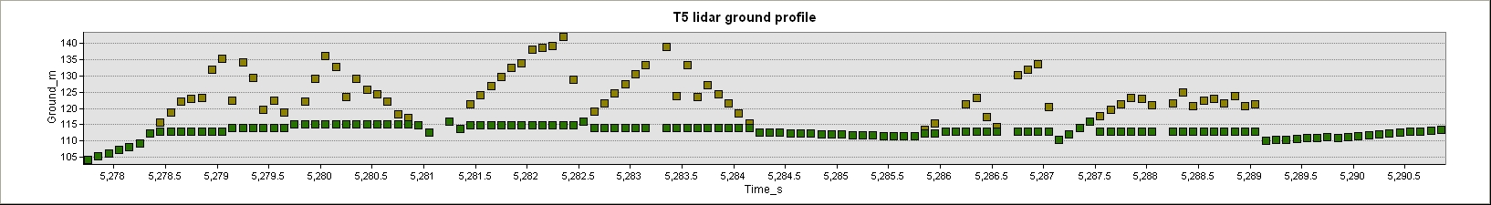
Lidar Groundline
ArcGIS 3-D Analyst
MatLab Scripts
DEM profile
Fix ground error
Recalculate canopy height
Notes:
Shorter time intervals
Better canopy structure, but
Less accurate ground trace
The figures on the right show an example of the exact same location ran with 2 different parameters. The tree tops are the (green line) and ground level is the (black line). first and last return points are shown in their exact locations.
Empirically narrow choices by looking at script figures of individual transects and weed out parameters with incorrect ground lines
We adjusted 2 parameters; the time interval- which were lengthened just enough so the program more accurately determined the ground lines. Different forest canopies did better at different time intervals, but we found 0.2 seconds to be effective overall.
The other parameter we adjusted was the omega/phi. Omega shows the orientation of the airplane on its x axis (roll) and high values can yield incorrect vertical results. We did not filter out any omega values as our transect width encompassed the variation.

Slide 27
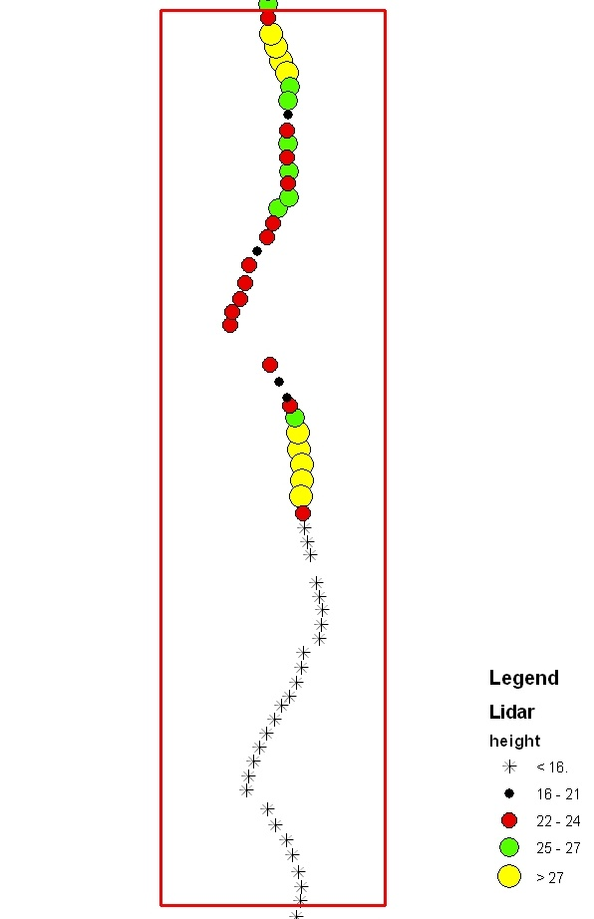
Within plot height variation
Biomass estimation due to lowered average height
Plot | Average lidar height (m) | Estimated biomass (Mg/0.5ha) | Estimated biomass (Mg/1.0ha)
7 N + S | 19.49 | na | 96.63
7 N | 25.77 | 103.11 | 206.22
7 S | 14.74 | 64.79 | 129.59
Sum of 7N + 7S biomass |  | 169.90
1-ha plot is 200m*50m

Slide 28
Two sources of error
Plot | Remote error
2.2 | 0.15
3 | -0.18
5 | -0.03
230 | -0.22
236 | 0.08
272 | -0.44
388 | -0.43
428 | 0.54
486 | -0.21
499 | 0.18

Slide 29
Biomass regression
biomass=125.492+(0.484*remote biomass estimation)
R²=0.499, p=0.022
Standardized residuals

Slide 30
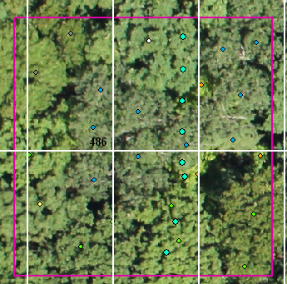
Calculating Biomass From
Lidar and Image Data
Total plot
biomass
Predicted height
Species total biomass
Species average biomass
Total stem density
dbh
Ln(dbh)
Stem density/ species
Lidar height
Identified tree
Scale to hectare
Notes:
Species rm, hi, wp, wo, ro, mh

Slide 31
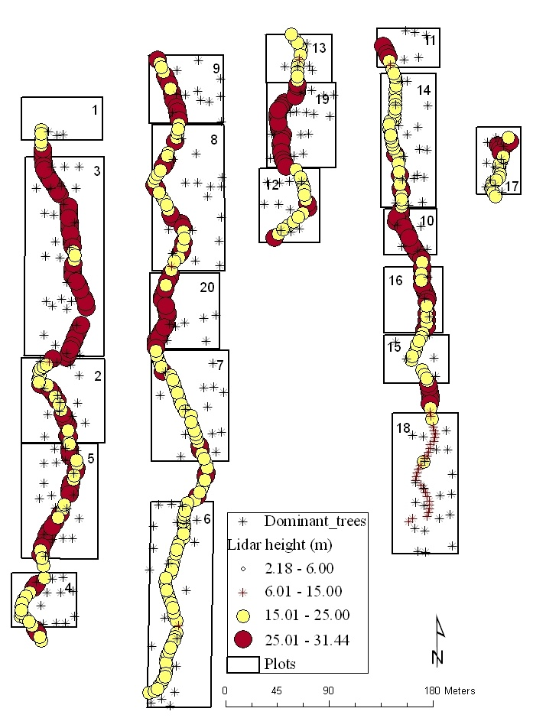
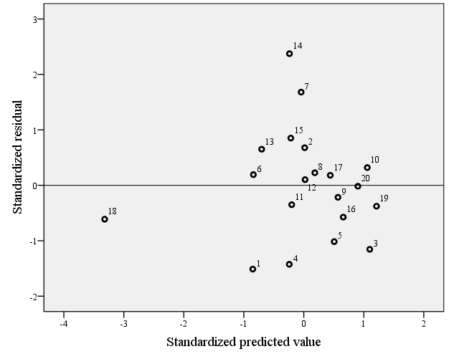
Lidar canopy underestimation

Slide 32
Biomass differences
Table 3. Comparison of remotely calculated biomass with ground biomass.
Plot | Remote | Ground bio all | Difference ground-remote | Lidar plot height average
2.2 | 259.27 | 224.66 | 34.61 | 30.14
3 | 168.69 | 205.48 | -36.79 | 24.05
5 | 274.47 | 283.25 | -8.78 | 28.03
230 | 225.15 | 289.72 | -64.57 | 27.24
236 | 314.95 | 290.94 | 24.01 | 29.88
272 | 70.62 | 125.34 | -54.72 | 14.22
388 | 137.90 | 243.24 | -105.34 | 24.98
428 | 254.70 | 164.92 | 89.78 | 27.77
486 | 162.60 | 205.32 | -42.72 | 26.13
499 | 344.90 | 293.26 | 51.64 | 31.22
Sum | 2213.25 | 2326.13 | -112.88

Slide 33
Lidar underestimation gradient
lidar height | height*slope | +constant | difference
5 | 5.48 | 5.991 | -0.991
10 | 10.96 | 11.471 | -1.471
15 | 16.44 | 16.951 | -1.951
20 | 21.92 | 22.431 | -2.431
25 | 27.4 | 27.911 | -2.911
30 | 32.88 | 33.391 | -3.391
35 | 38.36 | 38.871 | -3.871

Slide 34
Pearson’s Correlation
 | Dominant Stem Density (ground) | %Canopy | % Vis Image | Act. dom canopy %RO | Remote bio | Ground bio all
Dominant StemDen | 1
pctCanopy | .545 | 1
pctVis Image | -.593 | -.149 | 1
Actual dom. can %RO | -.632* | -.134 | .595 | 1
remote_bio | -.529 | .208 | .560 | .600 | 1
ground_bio_all | -.569 | .198 | .262 | .769** | .707* | 1
*. Correlation is significant at the 0.05 level (2-tailed). **. Correlation is significant at the 0.01 level (2-tailed).N=10 for all cases.

Slide 35
Other tentative estimations
p=0.016 (individual coefficients are not significant)
Removing 428 gives an R2 =0.91

