Slide 1
AUTOMATING GIS WITH PYTHON Spring NEARC
Kristina Grace
GIS Analyst
May 22, 2012

Slide 2
Topics
Broadband Availability and MassBroadband 123 maps
Create and document tools made from Python scripts
Script examples
error handling
tool parameters
check if path exists
where clause
calendar object
ArcToolbox: Conversion and Data Management
turn fields on and off in tables views
Online build phase map

Slide 3
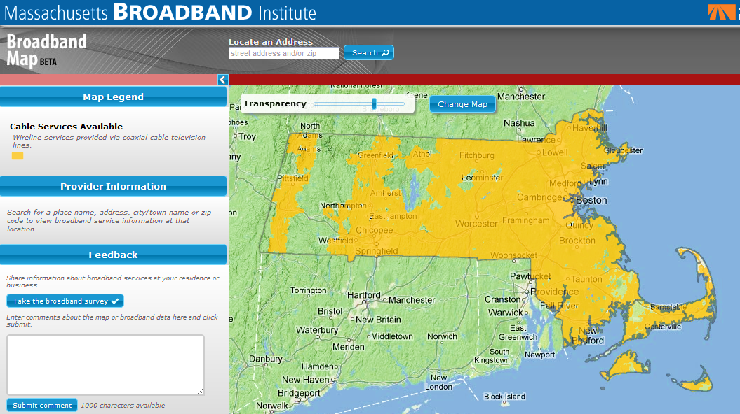
Broadband Availability Map
http://mapping.massbroadband.orgx

Slide 4
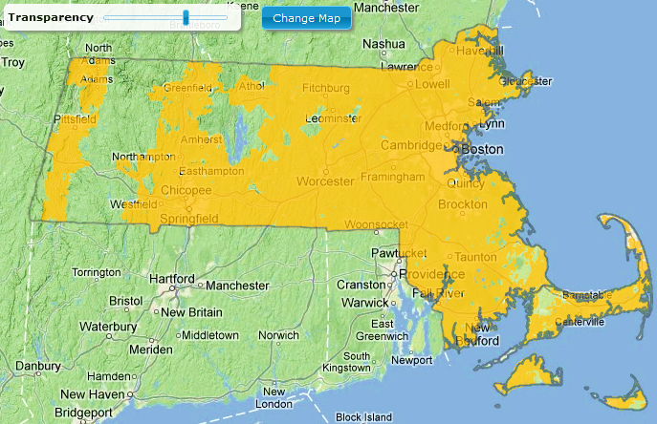
Cable Availability Map

Slide 5
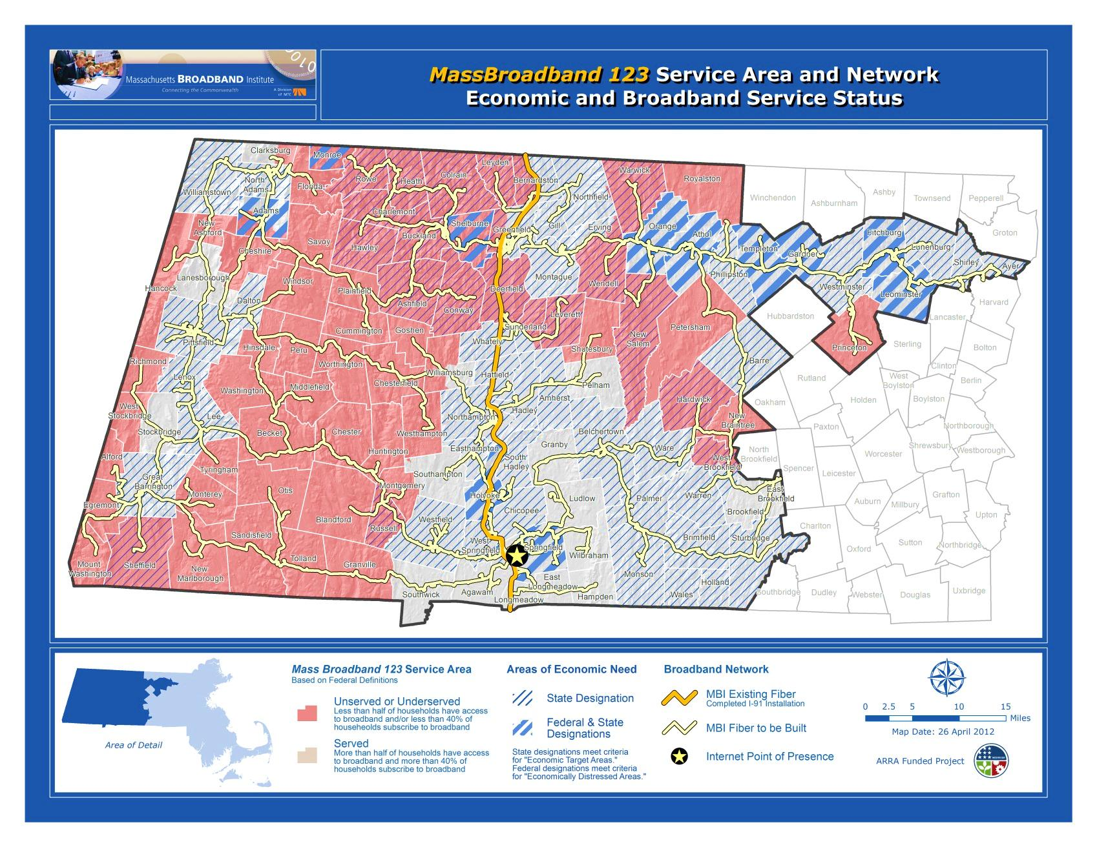
MassBroadband 123

Slide 6
Create And Document Tools
1. Create script
Python IDLE
use TEMPLATE.py
2. Add scripts to ArcToolboxes
add to tool or toolbox
3. Add description to tools
edit metadata
keywords
summary
parameter description
Notes:
Intergrated DeveLopment Envronment

Slide 7
Error Handling
processes inside try
error message formatting inside except
arcpy.GetMessages(2)
msgs = 'GP ERRORS:\n' + arcpy.GetMessages(2)

Slide 8
Delete Files And Feature Classes
arcpy.Delete_management(data_element)
arcpy.Delete_management(CWR3LogTbl)
Notes:
Delete_management(in_data, {data_type})
Permanently deletes data from disk. All types of geographic data supported by
ArcGIS, as well as toolboxes and workspaces (folders, geodatabases), can be deleted. If the specified item is a workspace, all contained items are also deleted.
INPUTS:
in_data (Data Element or Layer or Table View):
The input data to be deleted.
data_type {String}:
Data type of the Input Data Element. Data type is displayed for informative purposes and cannot be changed.

Slide 9
Check If Path Exists
if arcpy.Exists(dataset):
# do something
Path supported by ArcGIS:
arcpy.Exists("")
Path not supported by ArcGIS:
os.path.exists("")
if arcpy.Exists(FC):
arcpy.Delete_management(FC)
Notes:
If path is supported by ArcGIS use
arcpy.Exists("")
If path is not supported by ArcGIS use
os.path.exists("")

Slide 10
Tool Parameters
Param = arcpy.GetParameterAsText(0)
dateChangeParam = arcpy.GetParameterAsText(3)
Notes:
Data for Cost Analysis script

Slide 11
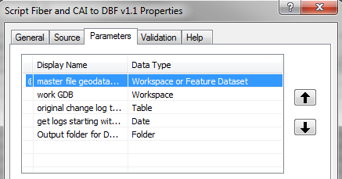
Tool Parameters
Notes:
Data for Cost Analysis script

Slide 12
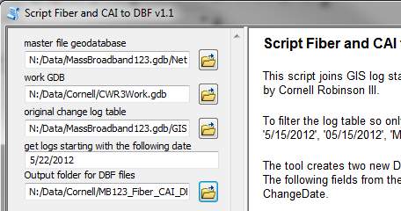
Extract Data For Cost Analysis

Slide 13
Export Feature Classes
Extract Data For Cost Analysis Script
arcpy.FeatureClassToFeatureClass_conversion(FC, out_path, out_name)
arcpy.FeatureClassToFeatureClass_conversion(MB123NetworkDSParam + '\\CAI', workGDBParam, CWR3CAIFC)

Slide 14
Where Clause
String variable
Field name needs to be surrounded by quotes
Used in
arcpy.SelectLayerByAttribute_management()
arcpy.MakeTableView_management()
whereClause = ' "fieldName" >= ' + variable
whereClause = ' "DateChange" >= ' + dateChange

Slide 15
Where Clause
Extract Data For Cost Analysis Script
where_clause = "IncInBuild <> 'N' and IncInBuild <> 'W'"
dateChange = 'date \'' + year + '-' + month + '-' + day + '\''
whereClause = ' "DateChange" >= ' + dateChange

Slide 16
Turn Fields On And Off
Extract Data For Cost Analysis Script
fieldinfo.addField (field_name, new_field_name, visible, split_rule)
fieldinfo.addField(field.name, field.name, 'HIDDEN', '')
Notes:
fields= arcpy.ListFields(changeLogTblParam) # Get the fields from the input
fieldinfo = arcpy.FieldInfo() # Create a fieldinfo object
# These are the fields that are needed for the export:
# DateChange, Requestor, Action, ID, Comments
for field in fields: # Iterate through the fields and set them to fieldinfo
if field.name == 'DateReques':
fieldinfo.addField(field.name, field.name, 'HIDDEN', '')
elif field.name == 'DateChange':
fieldinfo.addField(field.name, field.name, 'VISIBLE', '')

Slide 17
Join Tables And Feature Classes
Extract Data For Cost Analysis Script
arcpy.AddJoin_management(in_layer_or_view, in_field, join_table, join_field, {join_type})
arcpy.AddJoin_management(CWR3LogTblView, "ID",workGDBParam + "\\" + CWR3CAITbl, "CAI_ID",'KEEP_COMMON')

Slide 18
Add Fields To Feature Classes
Extract Data For Cost Analysis Script
arcpy.AddField_management(table, field_name, {field_type})
arcpy.AddField_management(workGDBParam + "\\" + CWR3LogTblJoinFiber, "Cost", "DOUBLE")
Notes:
AddField_management(in_table, field_name, field_type, {field_precision}, {field_scale}, {field_length}, {field_alias}, {field_is_nullable}, {field_is_required}, {field_domain})
Adds a new field to a table or the table of a feature class, feature layer,
raster catalog, and/or rasters with attribute tables.
INPUTS:
in_table (Table View or Raster Layer or Raster Catalog Layer or Mosaic Layer):
The input table to which the specified field will be added. The field will be added to the existing input table and will not create a new output table.Fields can be added to feature classes of ArcSDE, file or personal geodatabases, coverages, shapefiles, raster catalogs, stand-alone tables, rasters with attribute tables, and/or layers.
field_name (String):
The name of the field that will be added to the Input Table.
field_type (String):
The field type used in the creation of the new field.
* TEXT—Names or other textual qualities.
* FLOAT—Numeric values with fractional values within a specific range.
* DOUBLE—Numeric values with fractional values within a specific range.
* SHORT—Numeric values without fractional values within a specific range; coded values.
* LONG—Numeric values without fractional values within a specific range.
* DATE—Date and/or Time.
* BLOB—Images or other multimedia.
* RASTER—Raster images.
* GUID—GUID values
field_precision {Long}:
Describes the number of digits that can be stored in the field. All digits are counted no matter what side of the decimal they are on.If the input table is a personal or file geodatabase the field precision value will be ignored.
field_scale {Long}:
Sets the number of decimal places stored in a field. This parameter is only used in Float and Double data field types.If the input table is a personal or file geodatabase the field scale value will be ignored.
field_length {Long}:
The length of the field being added. This sets the maximum number of allowable characters for each record of the field. This option is only applicable on fields of type text or blob.
field_alias {String}:
The alternate name given to the field name. This name is used to give more descriptive names to cryptic field names. The field alias parameter only applies to geodatabases and coverages.
field_is_nullable {Boolean}:
A geographic feature where there is no associated attribute information. These are different from zero or empty fields and are only supported for fields in a geodatabase.
* NON_NULLABLE—The field will not allow null values.
* NULLABLE—The field will allow null values. This is the default.
field_is_required {Boolean}:
Specifies whether the field being created is a required field for the table; only supported for fields in a geodatabase.
* NON_REQUIRED—The field is not a required field. This is the default.
* REQUIRED—The field is a required field. This means new records must contain a value for the field. Required fields are permanent and can not be deleted.
field_domain {String}:
Used to constrain the values allowed in any particular attribute for a table, feature class, or subtype in a geodatabase. You must specify the name of an existing domain for it to be applied to the field.

Slide 19
Export file gdb tables to DBF
Extract Data For Cost Analysis Script
arcpy.CopyRows_management(in_rows, out_table)
arcpy.CopyRows_management(table, file.dbf)
Notes:
CopyRows_management(in_rows, out_table, {config_keyword})
Writes the rows from an input table, table view, feature class, or feature layer
to a new table. If a selection is defined on a feature class or feature layer in ArcMap, only the selected rows are copied out.
INPUTS:
in_rows (Table View or Raster Layer):
The rows from a feature class, layer, table, or table view to be copied.
config_keyword {String}:
The config keyword specifies the default storage parameters for an ArcSDE geodatabase.
OUTPUTS:
out_table (Table):
The table to which the rows will be written. If the output table already exists and the Geoprocessing Option: 'Overwrite the outputs of geoprocessing operations' is checked, it will be overwritten. To prevent overwriting from the tool dialog box, uncheck that option.The table to which the rows will be written. If the output table already exists, it will be overwritten. To prevent overwriting in a script, set the OverwriteOutput property on the geoprocessor object to false or 0.

Slide 20
Data Archiving Tool
Set up archive file gdb ahead of time
Set today’s date
Add today’s date to the output feature class when using Feature Class to Feature Class conversion tool

Slide 21
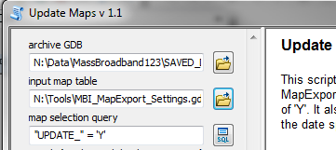
Update Maps Tool

Slide 22
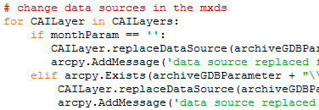
Replace Data Source
Update Maps Script
layer_name.replaceDataSource(gdb, "FILEGDB_WORKSPACE", new source feature class)
CAILayer.replaceDataSource(archiveGDBParam, "FILEGDB_WORKSPACE", 'CAI_' + now.strftime('%Y%m%d'))
Notes:
Map udpate script

Slide 23
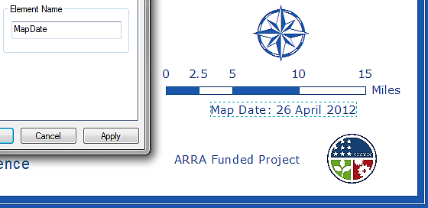
Update Map Elements

Slide 24
Change Date On Map
Update Maps Script
mapDate = arcpy.mapping.ListLayoutElements(map_document, {element_type}, {wildcard})[0]
mapDate = arcpy.mapping.ListLayoutElements(mxd, "TEXT_ELEMENT", "MapDate")[0]
Notes:
Map udpate script
mapDate = arcpy.mapping.ListLayoutElements(mxd, "TEXT_ELEMENT", "MapDate")[0]
if monthParam == '':
newMapDate = 'Map Date: ' + now.strftime('%d') + ' ' + now.strftime('%B') + ' ' + now.strftime('%Y')
else:
newMapDate = 'Map Date: ' + dayParam + ' ' + str(calendar.month_name[int(monthParam)]) + ' ' + yearParam
mapDate.text = newMapDate
print 'map date changed'
arcpy.AddMessage('map date changed')

Slide 25
calendar Object
Update Maps Script
methods
- month_name[]
- day_name[]
calendar.month_name[int(variable)]
str(calendar.month_name[int(monthParam)])
Notes:
>>> calendar.day_name[0]
'Monday'

Slide 26
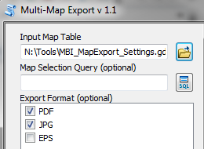
Multi-Map Export Tool

Slide 27
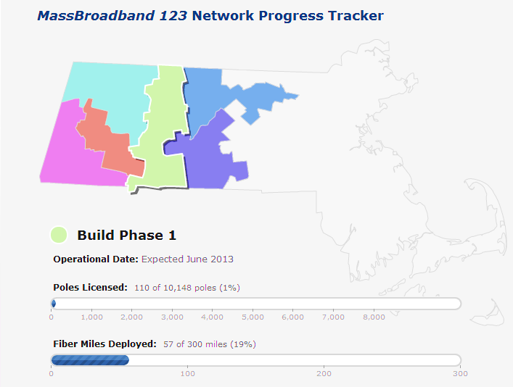
Online Build Phase Map
www.massbroadband.org
Notes:
http://www.massbroadband.org/Network/MBIprogresstracker.html

Slide 28
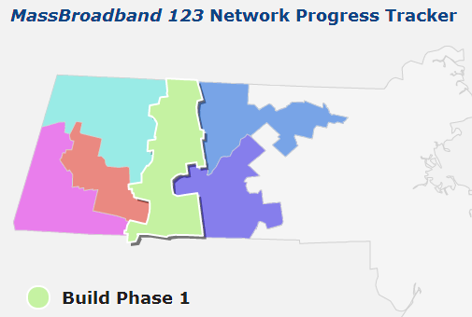
Online Build Phase Map
Notes:
http://www.massbroadband.org/Network/MBIprogresstracker.html

Slide 29
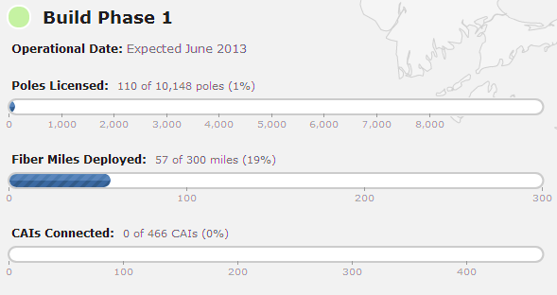
Build Phase Tracker
Notes:
http://www.massbroadband.org/Network/MBIprogresstracker.html

Slide 30
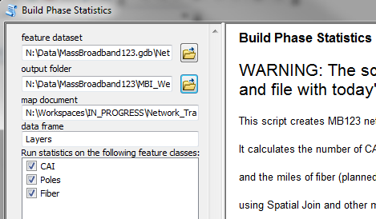
Progress Statistics Tool

Slide 31
Statistics Analysis
Online Build Phase Tracker Script
arcpy.Statistics_analysis(input_data,output_table,[[field,"COUNT"]], case_field)
arcpy.Statistics_analysis(asset,buildPhaseSJ + "_stats",[[assetPrimaryKey,"COUNT"]], BuildPhaseField)

Slide 32
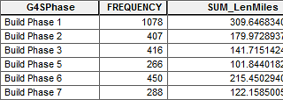
Statistics Analysis Output
Online Build Phase Tracker Script

Slide 33
SearchCursor Method
Online Build Phase Tracker Script
rows = arcpy.SearchCursor(table_name)
rows = arcpy.SearchCursor(buildPhaseSJ + "_stats")

Slide 34
getValue of Row
Online Build Phase Tracker Script
row.getValue(field.name)
for row in rows:
if row.getValue(myField.name) == "Build Phase 1":
bp1 = row.getValue(statsField.name)

Slide 35
Replace Text in File
Online Build Phase Tracker Script
text.replace(placeholder,new_number)
fileread = open(JSFileTEMPLATE, 'r')
filetext = fileread.read()
filetext = filetext.replace("BP1CCT",str(bp5))

Slide 36
Review
Met Python
Learned how to create and document tools from Python scripts
Saw Python script examples, such as defining variables and parameters, handling errors, exporting datasets, adding fields, getting field values, summamrizing data and using extra modules such as calendar and os
Saw Output example online

Slide 37
Resources
www.massbroadband.org
http://www.broadbandmap.gov
www.geospatialtraining.com
http://docs.python.org/library
E-mail: grace@masstech.org

